Slide 1
Humans in Mountain Environments
Julie Malmberg
November 4, 2009

Slide 2
Impacts of Mtn Environments
Lack of oxygen
Cold temperatures

Slide 3
Hypoxia
Definition = State when body is deprived of oxygen
Generalized hypoxia is also known as “altitude sickness” or “acute mountain sickness”
Ratio of oxygen does not change, but volume decreases with altitude
Does not effect everyone equally

Slide 4
Change in Oxygen Volume with Altitude

Slide 5
Symptoms of Hypoxia
Headaches, dizziness, confusion
Lack of appetite, nausea, vomiting
Fatigue, weakness, drowsiness
Swelling of hands, feet, face
Insomnia
Pins and needles in limbs/fingers
Shortness of breath during activity
Rapid Pulse
Pulmonary Edema (fluid in lungs)
Coughing
Fever
Shortness of breath
Cerebral Edema
Headache that does not get better with pain medication
Unsteady gait
Increased vomiting
Gradual loss of consciousness

Slide 6
Hypoxia Video
High Altitude Training – 25,000 ft

Slide 7
Treatment
Descend!
Avoid alcohol consumption
Avoid strenuous activity
Increase in altitude gradually (controlled ascent)
Medication
Supplemental oxygen
Drink water
Treatment in portable hyperbaric chamber
Steroids

Slide 8
Long Term Impacts

Slide 9
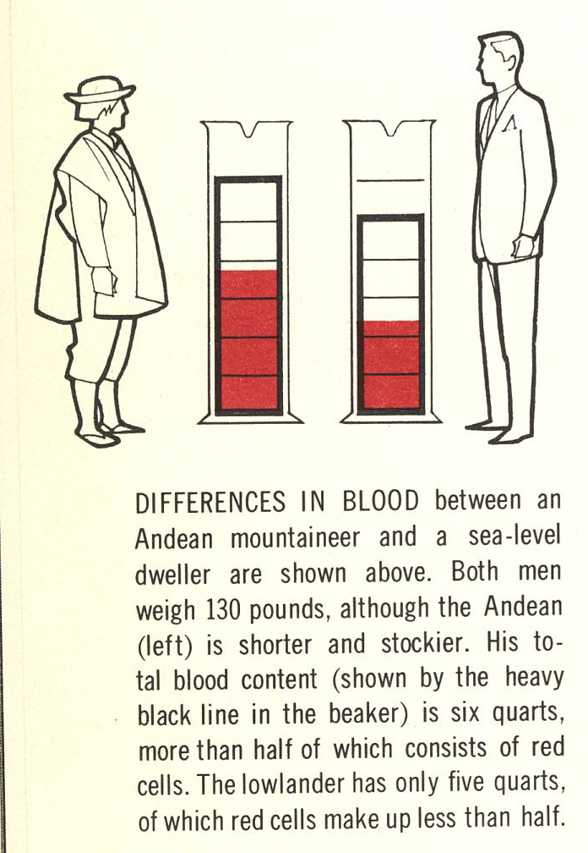

Slide 10
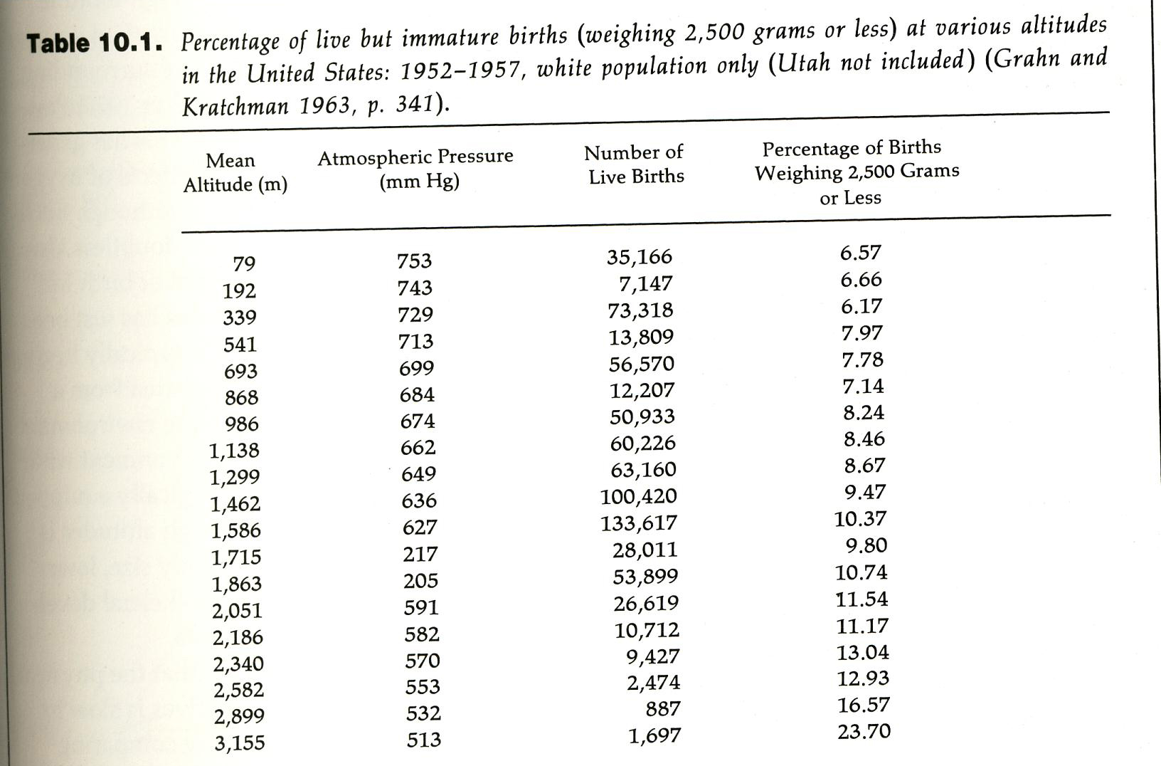

Slide 11
Hypothermia

Slide 13
Notes:
Countercurrent Flow

Slide 16
Notes:
Epicanthal fold

Slide 17
Notes:
Man from the Andes

Slide 18
Notes:
Tibetan man

Slide 19
Notes:
Nepalese woman

Slide 20
Review
Mountain Environments main impacts on people
Lack of Oxygen
Short term = altitude sickness
Long term = physiological changes
Cold Weather
Short term = hypothermia – moderate to severe
Long term = physiological changes

