Slide 1

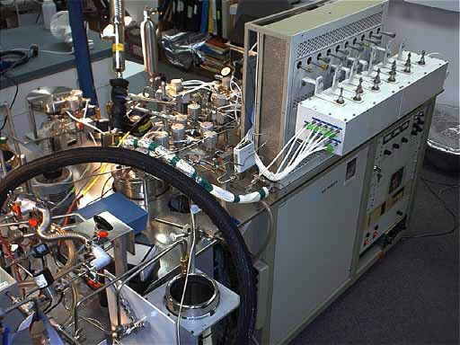
Introduction to Isotopes
Mark Williams, CU-Boulder

Slide 2
Outline
Introduction to isotopes
Collecting and analyzing samples
Fractionation
Dating
Mixing models
End-member mixing analysis

Slide 3

Solve all your
problems?
Protect you from
harm?
What are isotopes?
How are isotopes
helpful ?

Slide 4
Isotopes Defined
Isotope = atoms of the same element with a different number of neutrons (different mass)
Example: Oxygen Isotopes
Name | Electrons | Protons | Neutrons | Abundance
¹⁶O | 8 | 8 | 8 | 99.76%
¹⁸O | 8 | 8 | 10 | 0.20%

Slide 5
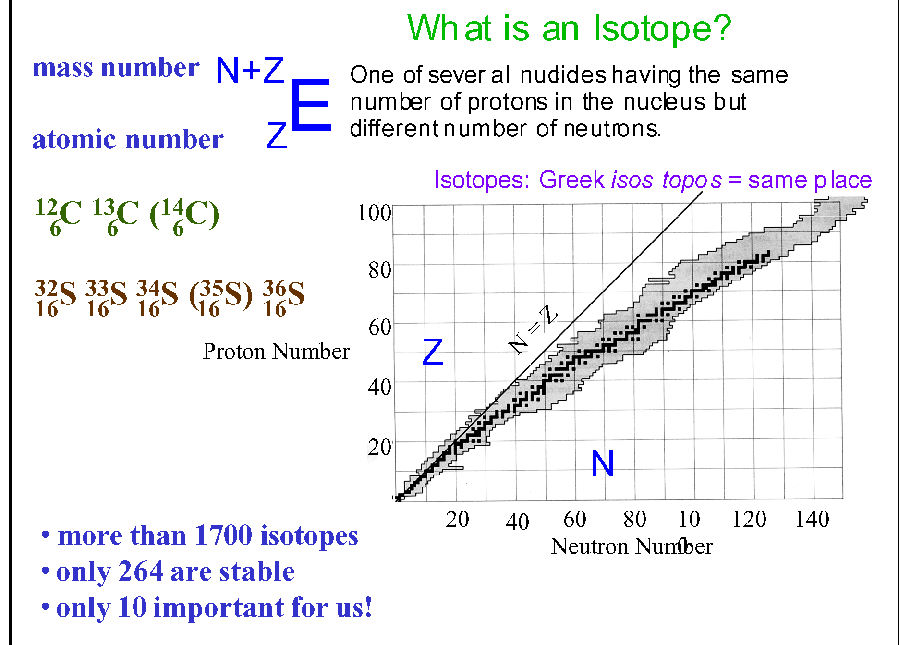
BMayer

Slide 6
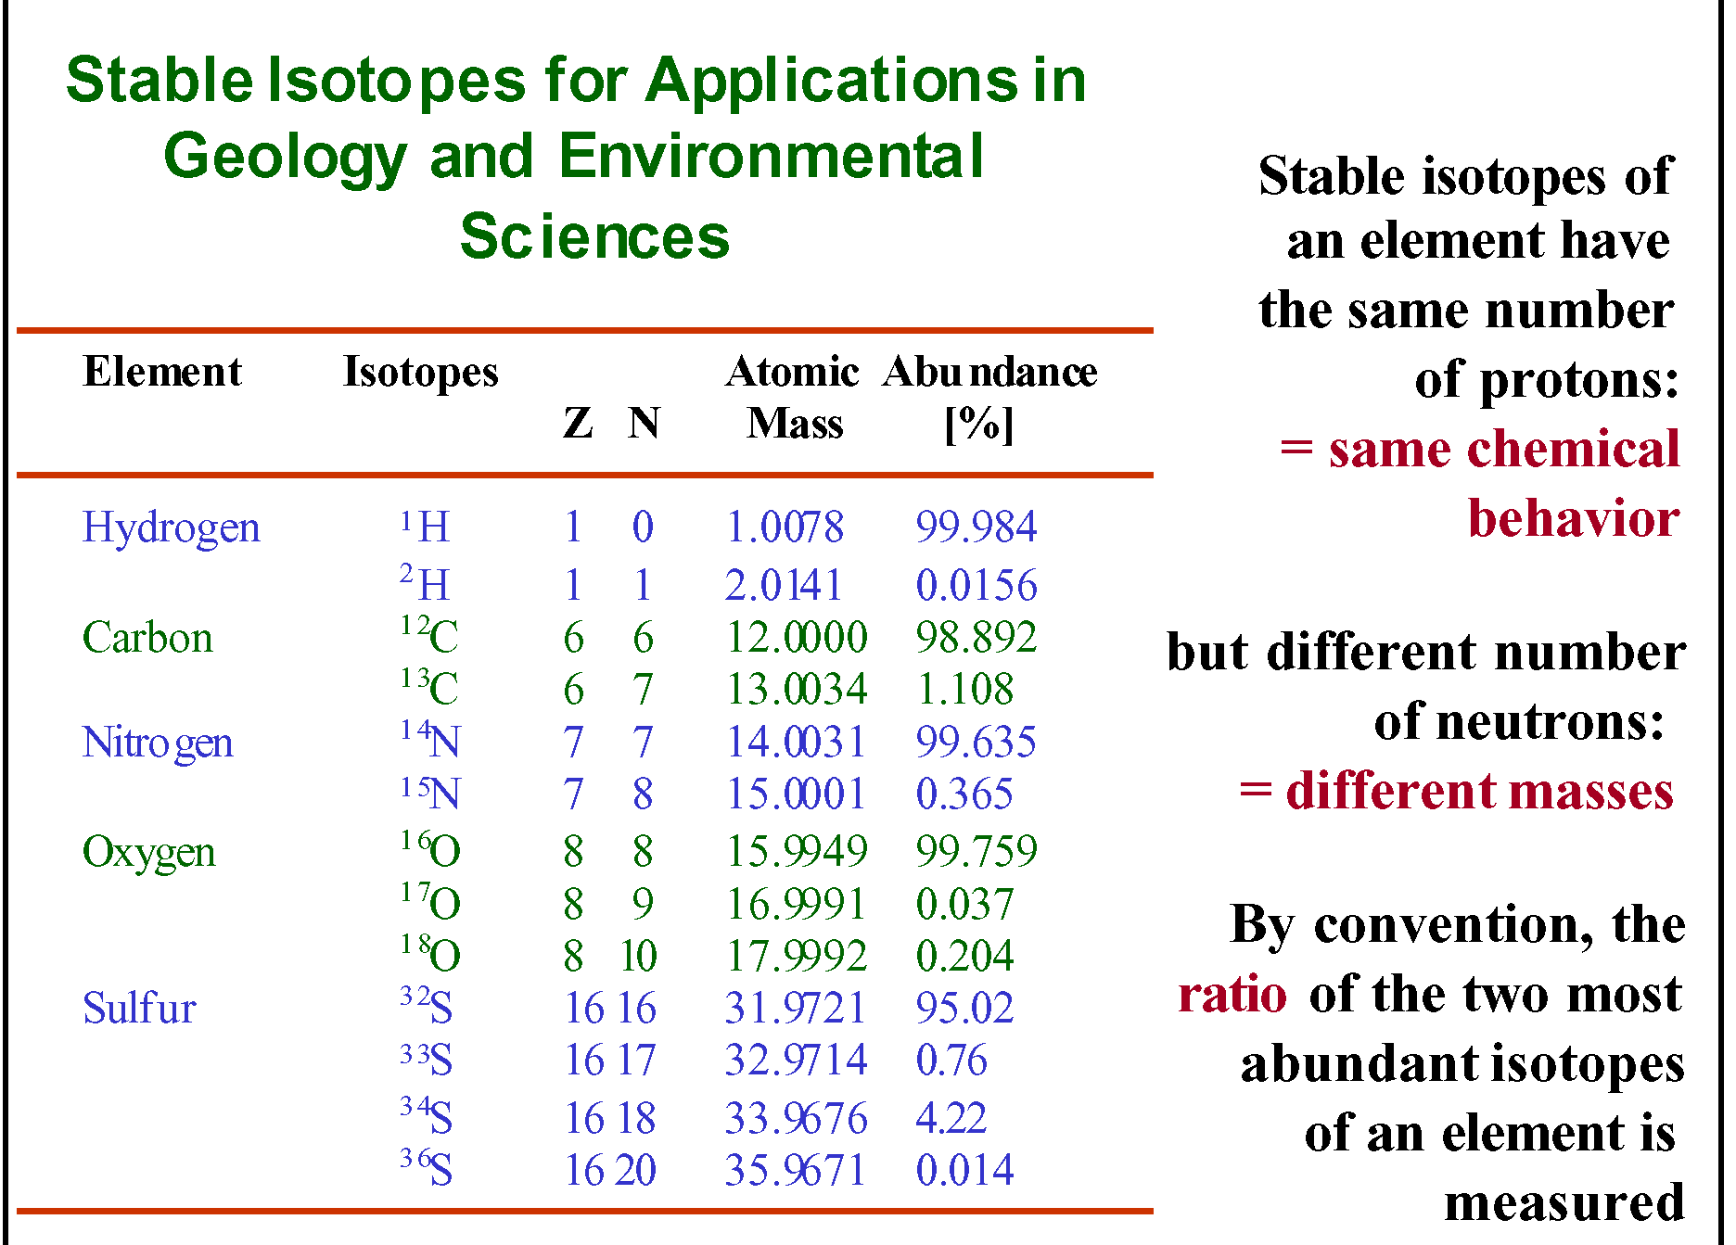
BMayer

Slide 7
Isotopic Ratios
Variation in the abundances of these stable isotopes is very small
Absolute abundances are difficult to analyze precisely
For most studies the RATIO of abundances is sufficient
Ratios can be determined about an order of magnitude more precisely than absolute abundances

Slide 8
Measuring Stable Isotopes
Stable isotope ratios are expressed as parts per thousand
(per mil – ‰) relative to a standard:
δ¹⁸Ο = [Rx/Rs -1] x 1000 = per mil (‰)
General Expression:
Where:
Rx = heavy isotope (¹⁸O) / light isotope (¹⁶O) in sample
Rs = heavy isotope (¹⁸O) / light isotope (¹⁶O) in standard

Slide 9
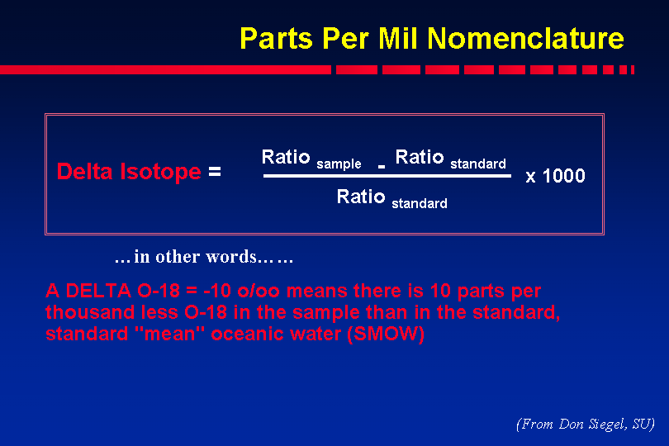

Slide 10
Environmental Isotopes
Stable Isotopes
Radioactive Isotopes
Do not decay spontaneously (stable over time)
Examples: ¹⁸O, ²H, ¹³C
Emit alpha and beta particles and decay over time
Examples: ³H (Tritium), ¹⁴C
Used as Tracers
Used for Dating

Slide 11

What are isotopes good for?
What is the source of the water?
What is the age of the water?
What is the source of solutes (including contaminants) in water?
Unique fingerprint

Slide 12
TRACERS IN HYDROLOGY
Kendall and McDonnell
Of all the methods used to model hydrological processes, tracers (isotopic and chemical) have provided the best new insights into the age, origin, and pathway of water movement.
They are among the few truly integrated measures of watershed function.
Nevertheless, these techniques are not often used because the are seen as too complex, too costly, or too difficult to use.

Slide 13
How many of you have had an isotope hydrology class?
Isotopes not taught in most engineering curriculum
Isotopes appropriate for hydrology not taught in most geology classes
Few, if any classes, that teach isotope hydrology

Slide 14
Isotope methods useful where traditional tools not helpful:
Southwest Hydrologist, 2003
Geological mapping of aquifer material
piezometric data
pump tests
hydraulic conductivity
major ion chemistry
and hydrologic models
give ambiguous results or insufficient information.

Slide 15
There is a trend toward more routine use of isotope tools by hydrologists
Southwest Hydrologist, 2003
The cost of analyses is quite reasonable
  More and more commercial labs
  Cheaper and faster optical methods coming online
One could possibly spend a few thousand dollars on isotopic analyses of water collected from existing wells and/or streams to produce a first order answer to a question that alternatively could require
  several labor-intensive pump tests,
  additional borehole installations, and/or a
  groundwater model that relies upon extensive water level data.

Slide 16
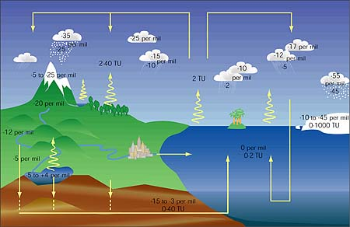

Slide 17
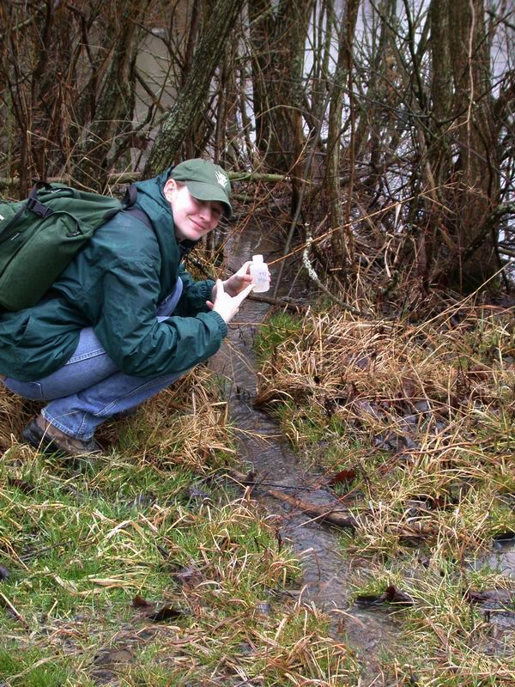
Sample collection and analysis for stable water isotopes:
Nuts and bolts
Mark Williams, CU-Boulder

Slide 18
Sample Collection: H and O examples
H and O collected in same bottle
30 mL more than adequate
  Glass bottles, store at 5 °C (special lids)
  Freeze in plastic bottles (don’t overfill)
No contamination problems
  Don’t need to rinse bottles
  Don’t need to filter (unless funky samples)
  Gloves not needed

Slide 19
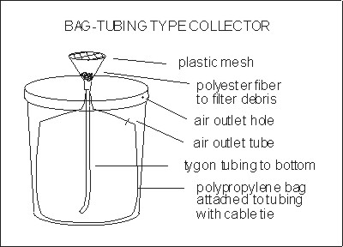
Precipitation Collector: H and O
Make your own
Cheap
Main problem is to prevent evaporation

Slide 20
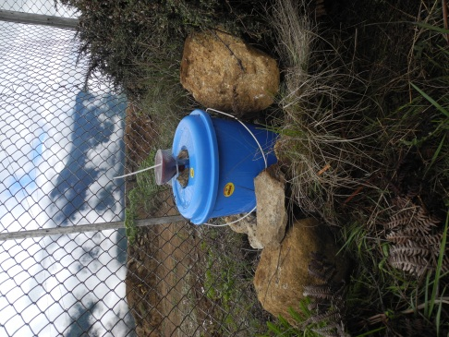
Precipitation Sampling
Overview
The purpose of each plastic bucket and funnel is to collect rain (or snow) for chemical isotope analysis (Oxygen-18 and Deuterium (Hydrogen-2)) and other chemistry data. Understanding how the chemistry of precipitation changes with elevation and how it changes over time is an important parameter for estimating source contributions to streamflow through End Member Mixing Analysis (EMMA).

Slide 21
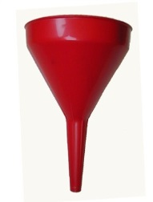
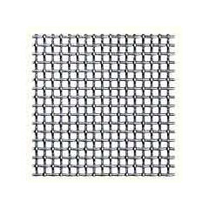
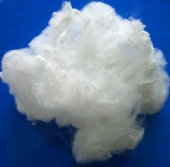
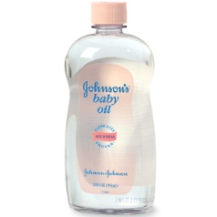
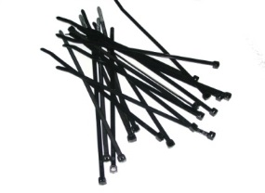
Precipitation Sampling
Supplies for construction:
1 plastic bucket for each sampling location – choose an appropriate volume based on expected precipitation
Lids for each bucket
Plastic funnels for each bucket (a long neck helps stabilize it inside the bucket)
Flexible mesh to cut and cover all funnels (keeps debris out)
Polyester fiber to filter dust (a small piece for each funnel)
Mineral oil (picture of Johnson’s Baby Oil) to serve as evaporation barrier. Enough to put 1cm of new oil in each bucket every time a sample is collected.
Zip ties for securing mesh
Silicone seal, tape, or another way to secure funnel to lid

Slide 22
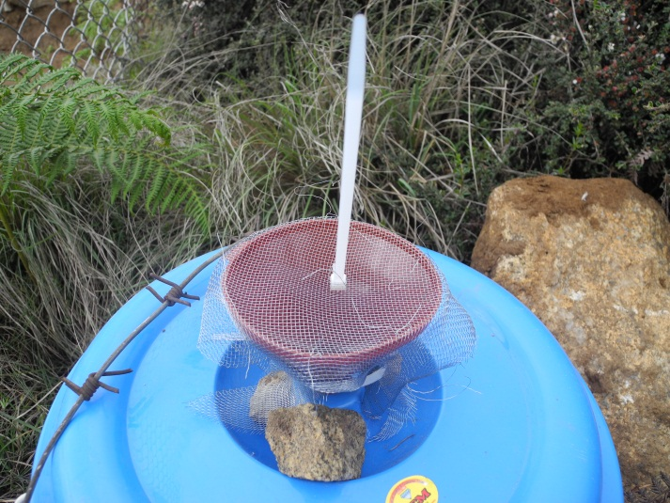
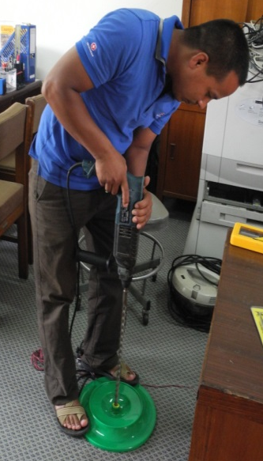
Precipitation Sampling (continued)
Bulk collector construction:
Put a hole in each lid, approximately the same size as funnel diameter
Insert funnel into lid (secured with tape or silicone sealant)
Put a small piece of polyester in the bottom of the funnel to filter dust
Cover funnel with mesh (mesh secured with zip ties)
Attach additional zip ties, pointing straight up to deter birds from landing

Slide 23
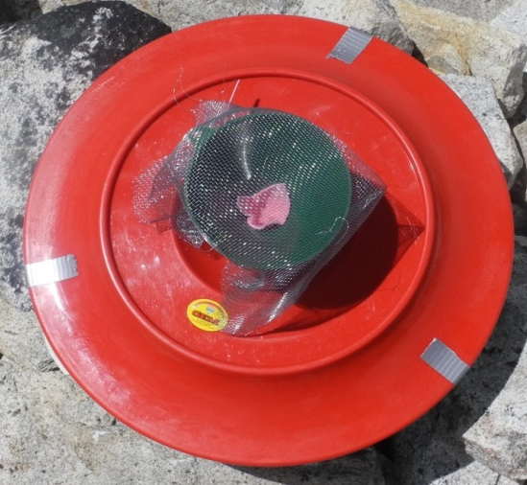
Precipitation Sampling (continued)
Bulk collector construction (continued):
Wrap all components (lids with funnels separated from buckets) in plastic bags to ensure no contamination from dust while in transit to the field.
To be done later, in the field: add mineral oil and attach lid. For field sampling
When installing the buckets at each location, they should be secured to the ground as best as possible (e.g. surrounded by rocks)

Slide 24
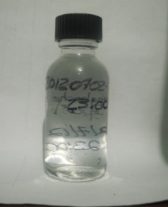
Precipitation Sampling (continued)
Precipitation sampling
The objective is to collect a 25mL sample of rain water from each bucket once per month. Supplies:
    100 mL plastic syringe
    25mL glass vial for sample
    Permanent marker for labeling sample bottle
    Mineral oil to refill the bucket
    Clean polyester or small cloth to insert in funnel to filter dust
    Extra cloth for wiping oil
    Duct tape to re-seal bucket lid

Slide 25
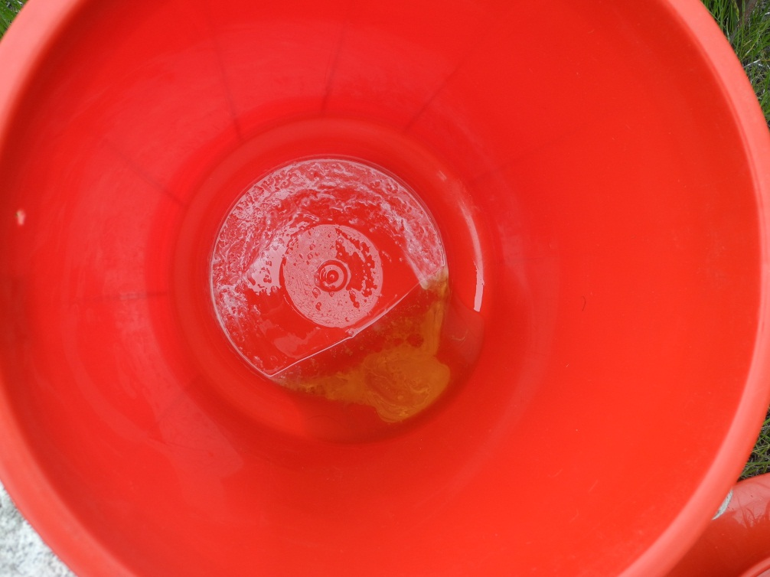
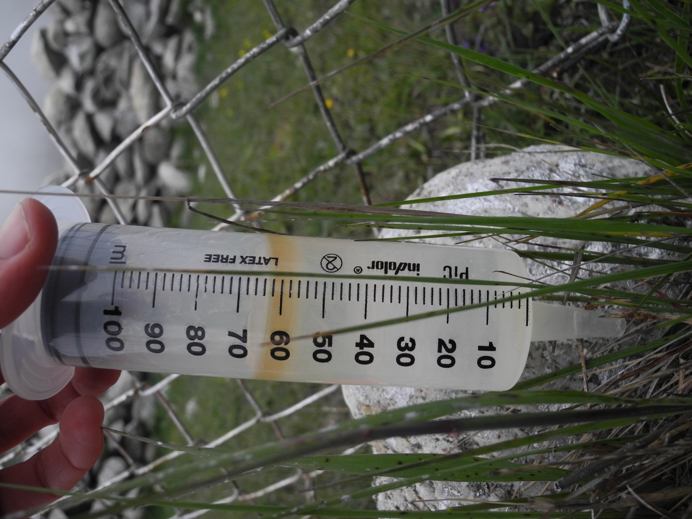
Precipitation Sampling (continued)
Precipitation sampling
Label the 25mL glass vial with a sample ID (date, location, sample type)
Remove the bucket lid
Insert clean syringe at least 5cm into bucket. If depth of liquid is less than 5cm, tilt the bucket and insert syringe all the way to bottom.
Draw ~60mL of rain (or snow) water into the syringe from under the oil layer
If there is oil in the syringe, wait for oil & water to separate so oil is not
included in the sample.

Slide 26

Precipitation Sampling (continued)
Pink square of clean cloth inserted into funnel to filter dust
Precipitation sampling
Inject rain water from syringe into the 25mL glass vial and fill to top
Empty the bucket and wipe clean
Add Mineral Oil to a depth of approximately 1cm
Replace the lid and duct tape closed
Secure the bucket
***If the amount of precipitation in the buckets is insufficient for sampling, the bucket should be emptied and wiped clean, and new oil should be added.

Slide 27
Groundwater/Surface Water Collection
Generally collected as grab samples
No special techniques or concerns
No training required

Slide 28
Except for glacial waters
High sediment content in glacial waters
Sediment messes up the analytical equipment
Use filters to remove sediment
  0.7 uM glass fiber filters, 47 mm in diameter
  May need to filter several times if high sediment load

Slide 29
Primary Isotopic Standards for stable isotopes in the environment
Waters
    V-SMOW (Vienna Standard Mean Ocean Water)
    SLAP (Standard Light Anarctic Precipitation)
    GISP (Greenland Ice Sheet Project)
Carbonates/ CO₂
    V-PDB (Veinna PeeDee Belemnite)
    NBS-19
Internal standards are calibrated to the primaries.
Primary standards are obtained from the International Atomic
Energy Agency (IAEA) in Vienna

Slide 30
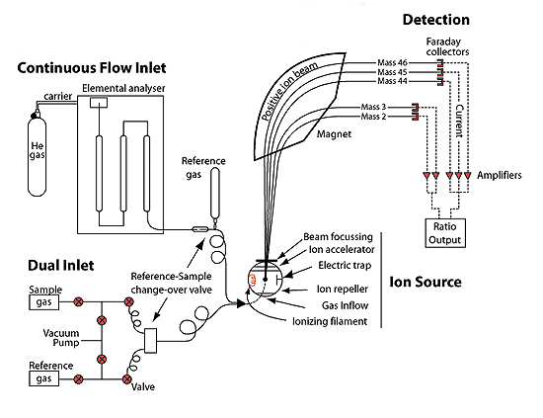
Gas Source: Isotope Ratio Mass Spectrometry (IRMS)

Slide 31
Water for oxygen isotope analysis by equilibration
~ 2 ml of water
~ CO₂ gas in head space
Equilibrate at known and steady temperature (25°C)
8 hours for exchange to completely occur
CO₂ carries isotopic signature of ¹⁸O in water

Slide 33
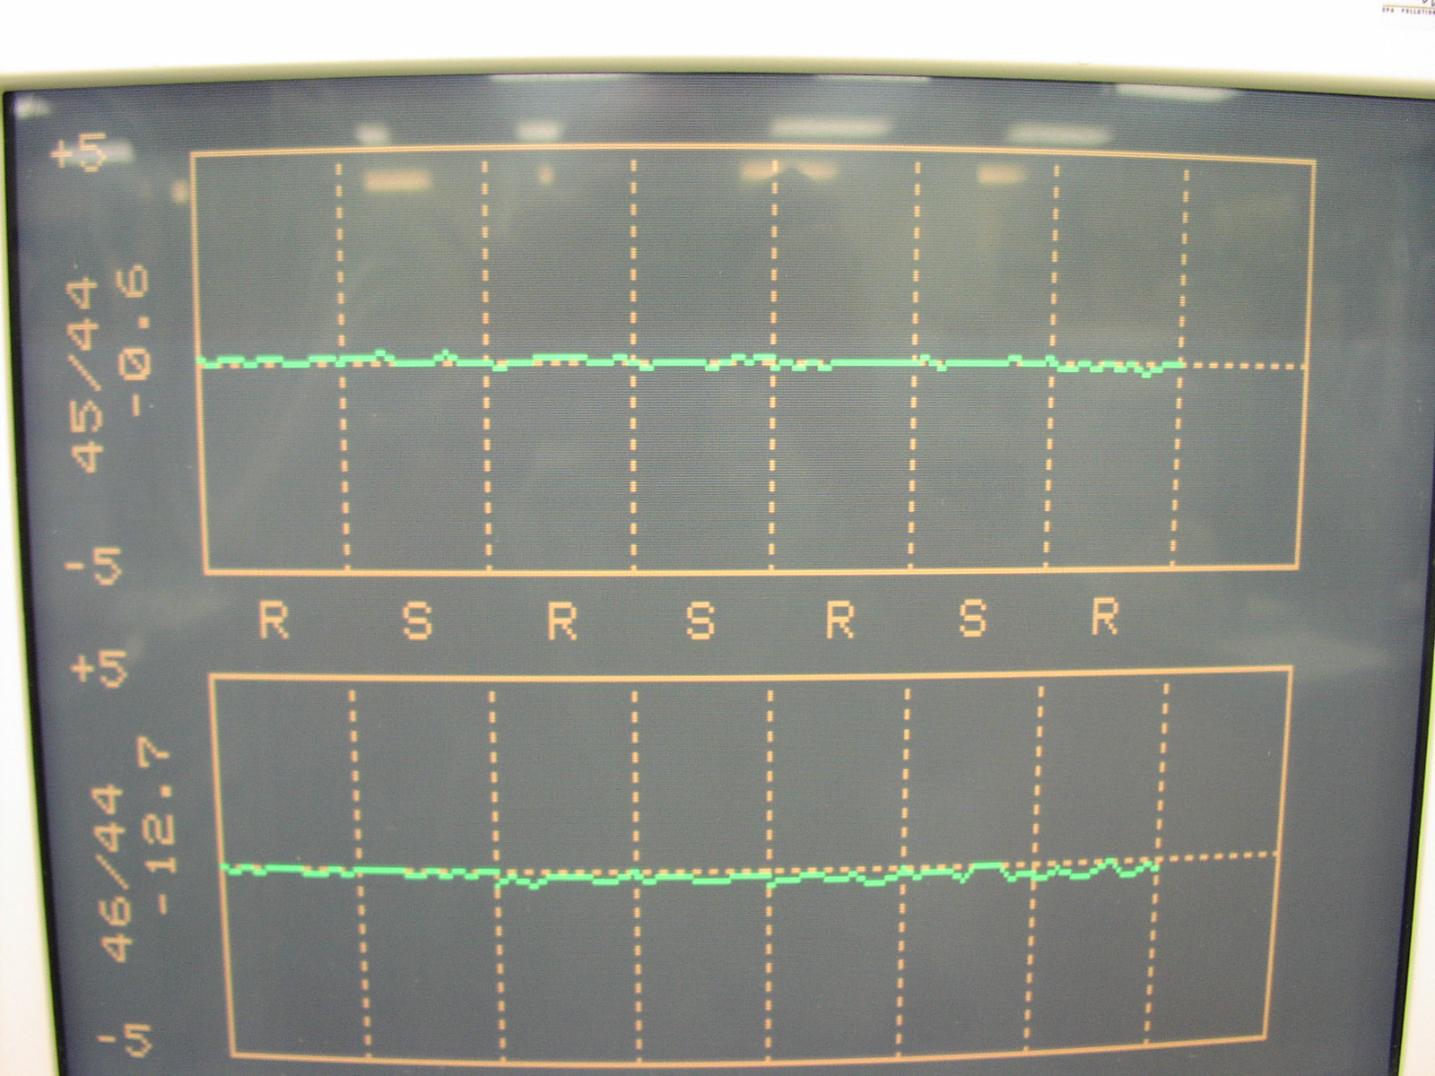
DUAL INJECTION SYSTEM
HIGH PRECISION: standard plus sample
precision less than 0.5‰

Slide 34
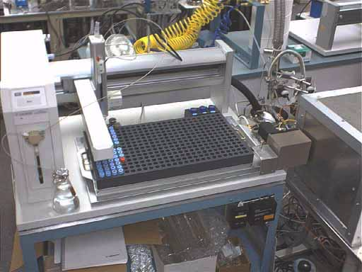
Water for hydrogen isotope analysis by Uranium reduction
Water is directly injected to evacuated chamber at 60°C.
Vaporized water bleeds to uranium at 600°C.
H₂O + U ⇒ H₂ + UO
Hydrogen to mass spec.
Can’t do high-conductance samples

Slide 35
Cost for isotopic analysis of H and O
Sampling bottles: $1 per sample
Analytical costs: $40 per sample per analyte
$80 per sample for both H and O
cheap

Slide 36
New optical instruments
Based on high-resolution direct-absorption spectroscopy
Size of a large suitcase
Real-time, in-situ measurements possible
High temporal frequency
Lower costs: about $5-10 dollars per sample
Los Gatos: main manufacturer
Piccaro: new and improved competitor
Lots of innovation here
$90,000 for complete set-up

Slide 37
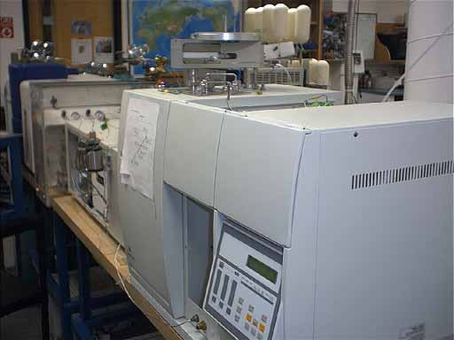
Elemental analyzer (EA)
determines the total amount of C, N, S, H and O present in samples
It can be coupled with a mass spectrometer (EA-MS) for isotopic analysis of the elements above
It can analyze organic samples from soils, seeds, plants, or sediments, algae, plankton

Slide 38
Isotope Geochemistry ~ Some useful links
Stable Isotope Lab at INSTAAR:
http://instaar.colorado.edu/sil
Download Mass Spec and prep-system lectures (9/11 & 9/13):
http://mysticplum.colorado.edu/groups/sil/docview.html
(or …follow the links from the Stable Isotope Lab web page above to “Technical Info” then “Document Downloads”.)
Mass Spectrometry
http://chemed.chem.purdue.edu/analyticalreview/mass_spec/massanalyzers.htm
Standards:
http://geology.uvm.edu/geowww/suppliers.html
http://patapsco.nist.gov/srmcatalog/reports/pricerpt.cfm
IAEA site Global Network of Isotopes in Precipitation (GNIP) and Isotope Hydrology Information System (ISOHIS)
http://isohis.iaea.org/
Deuterium Excess:
http://www.iaea.or.at/programs/ri/gnip/Precip6.html
USGS isotope program
http://wwwrcamnl.wr.usgs.gov/isoig/

Slide 39
What causes different isotopic values in source waters and flowpaths?
Mark Williams, CU-Boulder

Slide 40
Isotopes Defined
Isotope = atoms of the same element with a different number of neutrons (different mass)
Example: Oxygen Isotopes
Name | Electrons | Protons | Neutrons | Abundance
¹⁶O | 8 | 8 | 8 | 99.76%
¹⁸O | 8 | 8 | 10 | 0.20%

Slide 41
Fractionation
Lighter isotopes are separated from heavier isotopes during phase changes or chemical formation of new compounds

Slide 42
Reasons for isotopic fractionation
Isotope fractionation occurs because the bond energy of each isotope is slightly different.
Heavier isotopes have stronger bonds and slower reaction rates.
The difference in bonding energy and reaction rates are proportional to the mass difference between isotopes.
Thus, light elements are more likely to exhibit isotopic fractionation than heavy isotopes.

Slide 43
Reasons for isotopic fractionation
For example, the relatively light ¹²C and ¹³C isotopes have an 8% mass difference and undergo stable isotope fractionation.
In contrast, the heavy isotopes ⁸⁷Sr and ⁸⁶Sr have a 1.1% mass difference and do not exhibit detectable mass fractionation.
Isotopes especially susceptible to fractionation are are among the most abundant elements on earth: H, C, N, O, and S.

Slide 44
Stable Isotopes
¹⁶O (Light Element)
¹⁸O (Heavy Element)
Phases changes
can sort the light elements from the
heavy elements
Fractionation
Change in δ¹⁸O value

Slide 45
Water Molecule example
“Light” bonds (bonds between the
light isotopes) are broken more easily
than “heavy” bonds
“Heavy” bonds are made first
¹H and ¹⁶O evaporate preferentially
²H and ¹⁸O condense preferentially

Slide 46
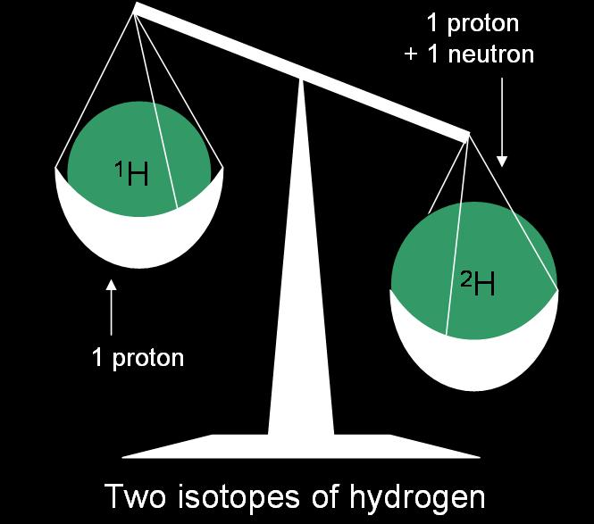
Mass dependent fractionation

Slide 47
Equilibrium fractionation
Equilibrium isotope-exchange reactions involve the redistribution of isotopes of an element among various species or compounds. At equilibrium, the forward and backward reaction rates of any particular isotope are identical. This does not mean that the isotopic compositions of two compounds at equilibrium are identical, but only that the ratios of the different isotopes in each compound are constant.
For water, this happens when relative humidity is 100%.

Slide 48
Fractionation During Evaporation
Kinetic fractionation is associated with incomplete and unidirectional processes such as evaporation and diffusion.
The lower the relative humidity, the faster the evaporation rate and the greater the kinetic fractionation.
Can add a unique isotopic “fingerprint” to near surface waters
  Lakes, canals, settling ponds, large rivers (eg Colorado)

Slide 49
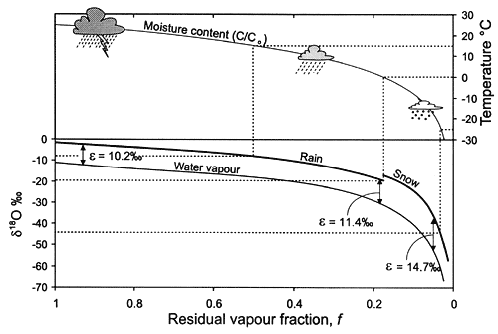
Rayleigh distillation

Slide 50
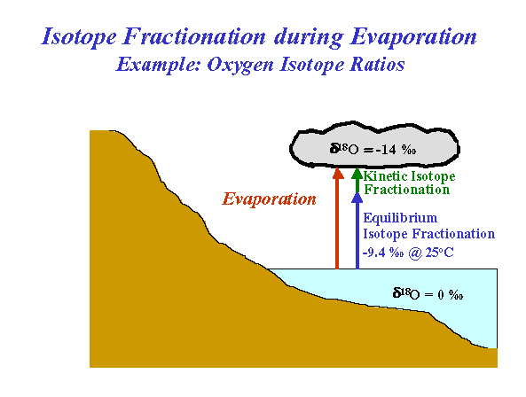
BMayer

Slide 51
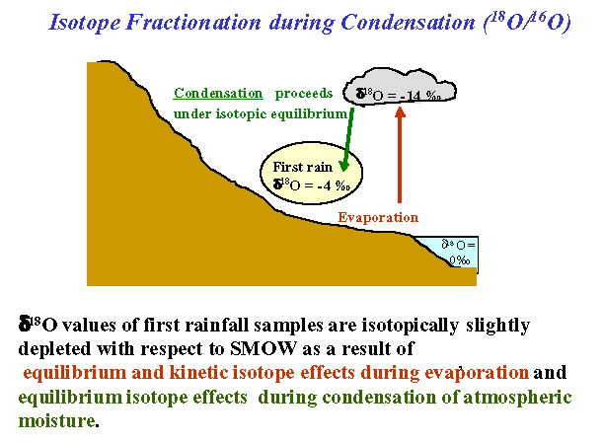
BMayer

Slide 52
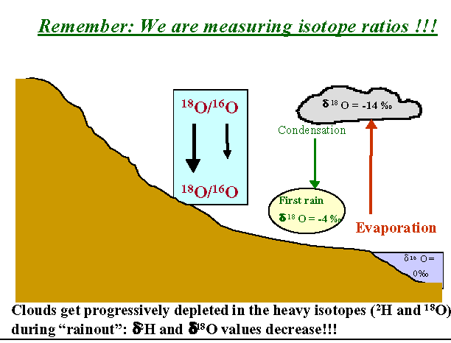
BMayer

Slide 53
Water Isotopes in Precipitation
Lighter isotopes evaporate preferentially
Heavier isotopes condense preferentially
For a given cloud:
  Heavier isotopes condense (rain or snow) preferentially
  Remaining water vapor in the cloud is more depleted
  Next rain event from that same cloud preferentially loses the heavier isotopes
  Water vapor in cloud becomes more depleted
  And so on

Slide 54
CONTROLS ON ISOTOPIC COMPOSITION OF PRECIP
Temperature
Seasonal
Altitude
Latitude
Rainout
Continental

Slide 55
Temperature is the dominant control on fractionation
With increasing temperature, precipitation becomes enriched in the heavier isotopes,¹⁸O and ²H, in a linear relationship.
  Warmer the air temp, the less fractionation
Temperature affects fractionation at a rate of approximately 0.5‰ for every C° for oxygen.
Colder the temperature, the more the fractionation

Slide 56
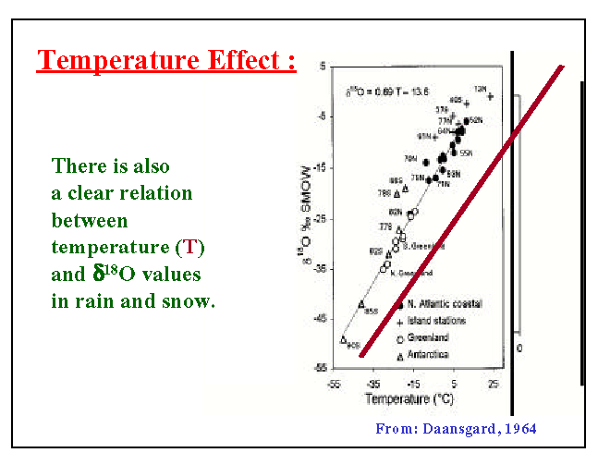

Slide 57
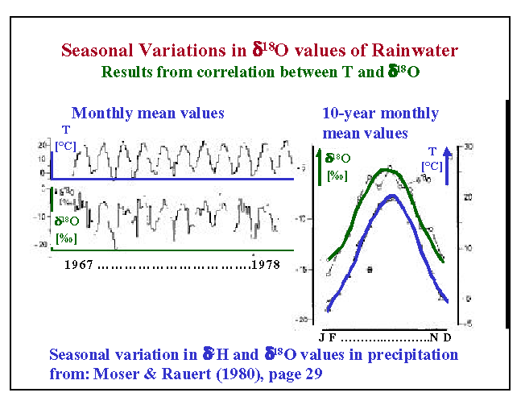

Slide 58
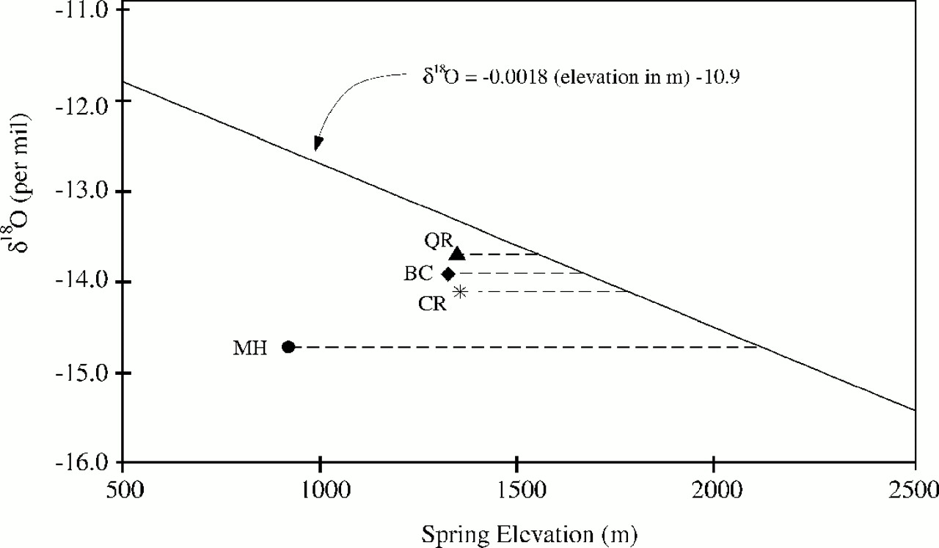
δ¹⁸O gives recharge elevation
Elevation versus δ¹⁸O in the central Oregon Cascades; line is a best-fit to data from
snow cores and small springs (after James 1999), and symbols are data from large cold
springs. The mean recharge elevation can be inferred by determining the elevation at
which precipitation has a comparable isotopic composition. BC, Brown's Creek; CR,
Cultus River; MH, Metolius River; QR, Quinn River. (Manga, 2001).

Slide 59
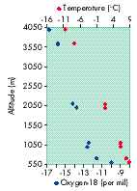
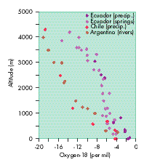
Altitude effect
GNIP

Slide 60
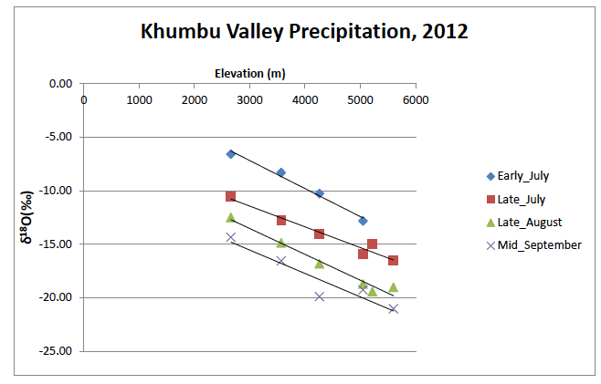
Isotopic values of precipitation: will allow us to
run mixing models: Italian-American cooperation

Slide 61
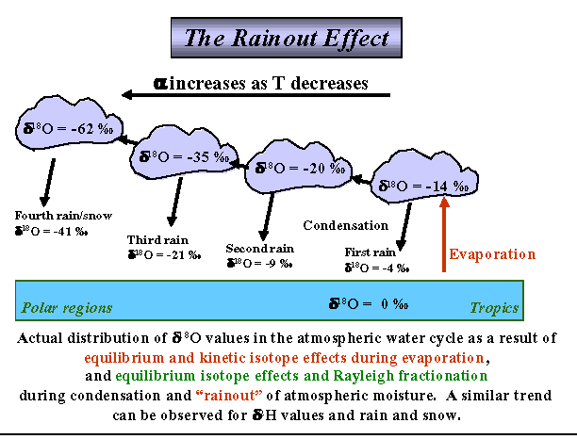
BMayer

Slide 62
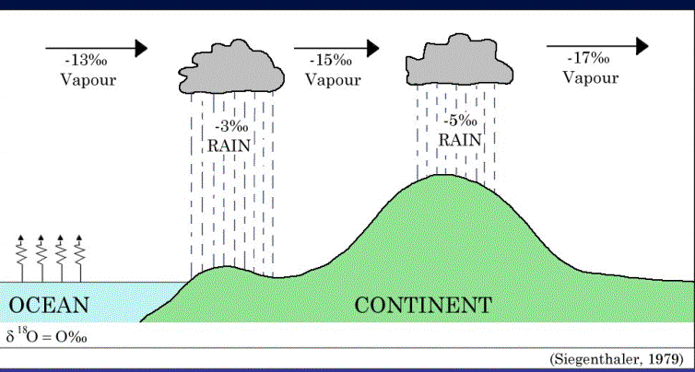
Continentality

Slide 63
Review: ocean water has a SMOW value of 0⁰/00
Lighter (more negative) isotopes evaporate preferentially
Clouds have a NEGATIVE δ¹⁸O value
Rain: heavier (less negative) isotopes preferentially condense from the cloud
Water vapor in clouds get progressively more negative over time and distance
Provide a unique “fingerprint” to source waters and flowpaths

Slide 64
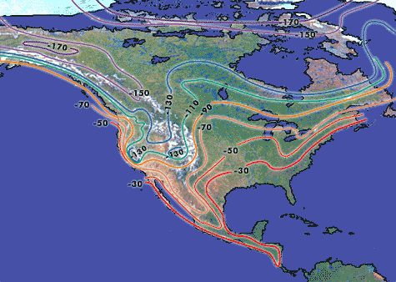
Continentality, latitude, elevation
Deuterium values get lighter with latitude, towards interior of continent,
and along mountain ranges: note sharp decrease in Sierra Nevadas

Slide 65
Mountains
Isotopes in precipitation become more negative with elevation
Isotopes become more negative with colder temperatures
Isotopes become more negative with increasing distance from oceans
Karakorams, Tien Shan should fit this pattern
Monsoon screws all this up

Slide 66
Precipitation and equilibrium fractionation
The δD and δ¹⁸O values for precipitation worldwide behave predictably, falling along the global meteoric water line (GMWL) as defined by Craig (1961b)
δ²H = 8 δ¹⁸O +10‰
This relationship for ¹⁸O and ²H isotopes is primarily a reflection of differences in their equilibrium fractionation factors. The slope of the GMWL expresses this ratio, which is eight times greater for oxygen than hydrogen.

Slide 67
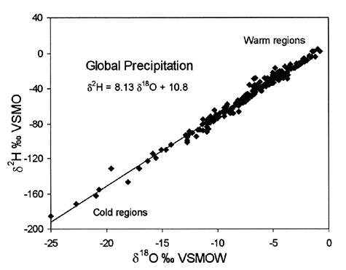
Global Meteoric Water Line
Clark and Fritz 1997, p. 37, as compiled in Rozanski et al. 1993,
modified by permission of American Geophysical Union.

Slide 68
Fractionation During Evaporation
Kinetic fractionation is associated with incomplete and unidirectional processes such as evaporation and diffusion.
The lower the relative humidity, the faster the evaporation rate and the greater the kinetic fractionation.
Can add a unique isotopic “fingerprint” to near surface waters
  Lakes, canals, settling ponds, large rivers (eg Colorado)

Slide 69
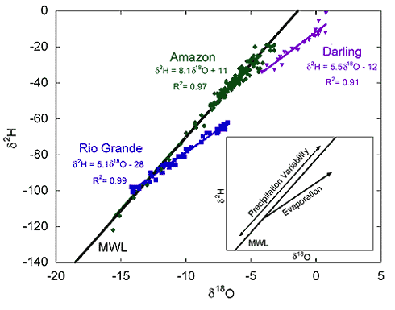
Evaporation signal for lakes and rivers

Slide 70
Evaporation from lakes and rivers
At very low relative humidities (< 25%) the slope of the evaporation line will be close to 4
for moderate relative humidities (25% to 75%) the slope will be between 4 and 5
only for relative humidities above 95% does the slope approach 8, the slope of the meteoric water line

Slide 71
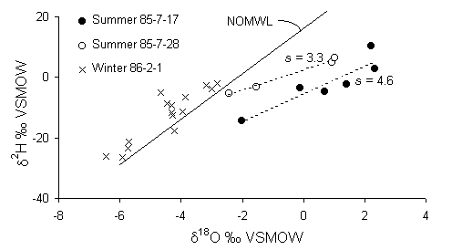
Local meteroric water line (LMWL)
The isotopic composition of wadi runoff for three rainfall events in northern Oman.
The regression lines for the summer rains (slopes indicated) show strong evaporation
trends at humidities less than 50%. The local water line for northern Oman (NOMWL)
is defined as δ²H = 7.5 δ¹⁸O + 16.1.

Slide 72
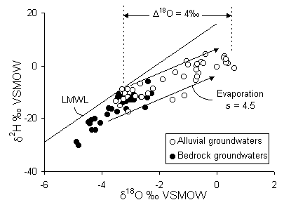
LMWL and recharge
Deep groundwaters from fractured carbonate aquifers and shallow alluvial
groundwaters in northern Oman. Alluvial groundwaters have experienced
greater evaporative enrichment. Also shown is the average evaporation slope
(s = 4.5) for the region, with h = 0.5.

Slide 73
Deuterium excess (d)
In addition to the phase changes under equilibrium
conditions, a kinetic effect results from a different
diffusivity for the isotopically different water molecules
in air. The higher diffusivity for ²H¹H¹⁶O relative to
¹H¹H¹⁸O results in an additional separation, a higher
deuterium excess (d).
Deuterium excess is simply the y-intercept of the
xy scatter plot for deuterium and δ¹⁸O.
Another isotopic tool

Slide 74

Deuterium excess can identify recycled continental/arid waters
Increased deuterium excess in precipitation can also arise from significant
addition of re-evaporated moisture from continental basins to the water
vapour travelling inland. If moisture from precipitation with an average
excess of 10 per mil is re-evaporated, the lighter ²H¹H¹⁶O molecule may
again contribute preferentially to the isotopic composition of the water vapour
and this, in turn, leads to an enhanced deuterium excess in precipitation.
Examples of deuterium enriched precipitation derived in this way are known
from the Amazon Basin (above) and the Great Lakes Region in North America

Slide 75
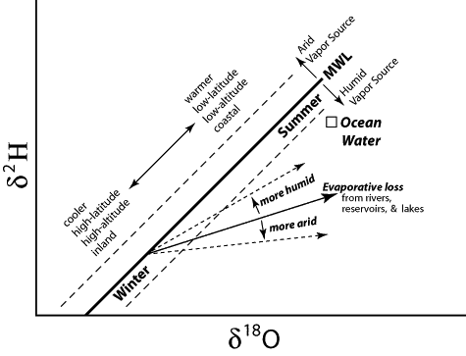
Summary 1

Slide 76
Summary 2
fractionation processes often provide a unique isotopic signal to different water bodies
Lighter isotopes evaporate preferentially
  Heavier isotopes left behind
Heavier isotopes condense
  Precipitation is heavier than the cloud it came from
  Clouds become progressively depleted
Fractionation rates increase as air temperatures become colder
Deuterium excess can provide helpful information

