Slide 1
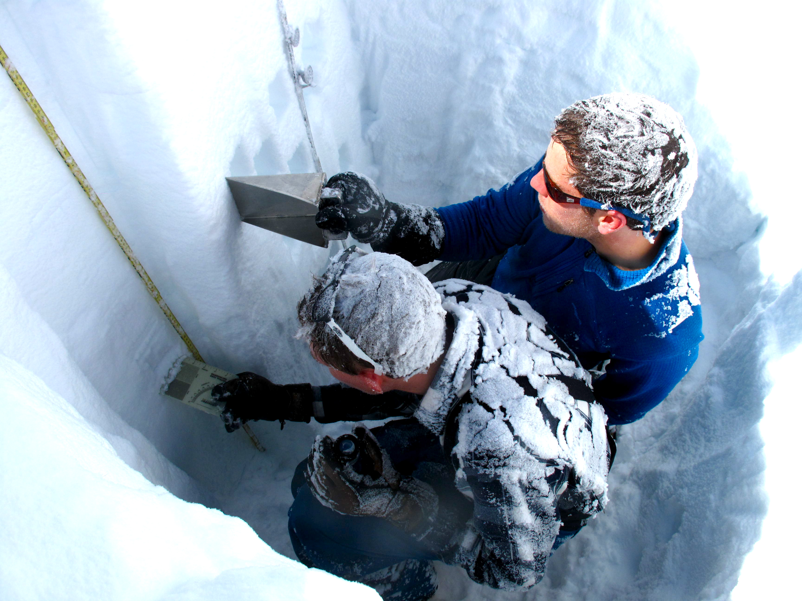






We discover the mechanisms that drive environmental change.
We conduct interdisciplinary science that can help us understand and manage grand challenges surrounding climate change, water, agriculture, and ecosystems health.
instaar.colorado.edu
@instaar

Slide 2
Overview
Intro to hydrology
  Hydrologic cycle
  Continuity equation
  Hydrologic equation
Measuring snow
Hydrograph
Mountains as water towers
Snow/ice melt models
Climate change

Slide 3
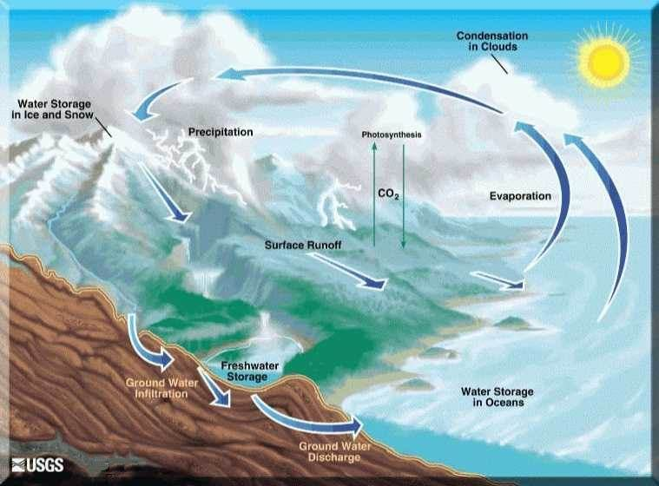

Slide 4
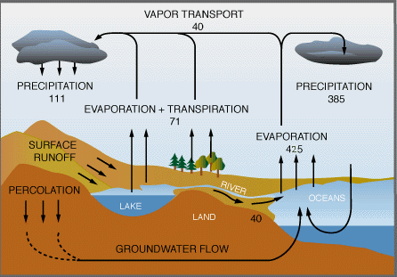
Water fluxes

Slide 5
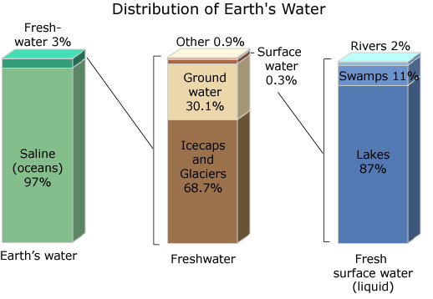

Slide 6
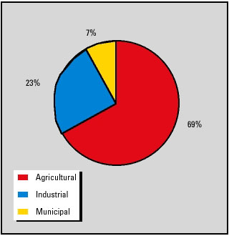
GLOBAL WATER USERS

Slide 7
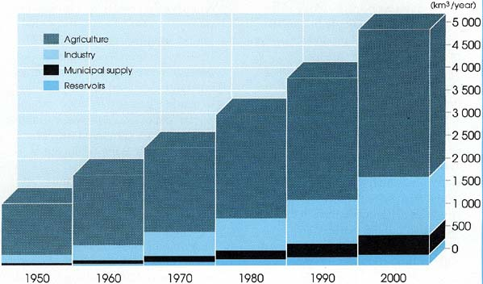
INCREASING GLOBAL USE
OF WATER

Slide 8
Hydrologic cycle components
Each path of hydrologic cycle involves one or more of the following (a) transportation of water (b) temporary storage and (c) change of phase/state.
The quantities of water going through various individual paths of the hydrologic cycle can be described by the continuity equation or hydrologic equation.

Slide 9
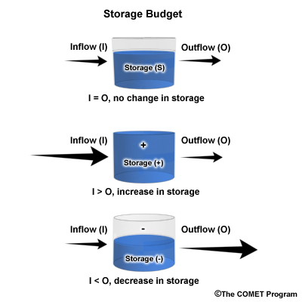
Conservation of mass
The principle of conservation of mass states
simply that mass must be conserved for any
fluid in motion.
The total water resources of the earth are
constant.
Which leads to the concept of a control
volume.

Slide 10
Continuity equation
q = i – ΔS
  i is the rate of input (e.g. of precipitation)
  q is the rate of output (e.g. of runoff) and
  dS/dt is the rate of change in storage (e.g. of a lake)
For example, the basis of reservoir management to control in-stream flows (q) below the reservoir.

Slide 11
Residence Time (T_{r})
the average duration for a water molecule to pass through a subsystem of the hydrologic cycle
Tr = Volume of water in storage (S) in a subsystem / Flow rate (Q) in the same subsystem.
Tr = S/Q

Slide 12
Residence times
Oceans about 3,000 years
Glacier ice 20-100 years
  900,000 years oldest ice in Antarctica
Atmosphere about 7-9 days
Humans about 4 days

Slide 13
Hydrologic equation
Mass inflow – mass outflow = change in storage
P – R – G – E – T = S
where P – precipitation, primary input and the starting point in the analysis; R – runoff; G – groundwater; E – evaporation; T – transpiration. All terms in equation have dimensions of volume but can be expressed as depth over the catchment. Infiltration does not appear explicitly in the water budget equation, because it is loss to runoff but a gain to groundwater system.

Slide 14
Hydrologic equation
If Gin = Gout, we can rewrite as
Q = P – ET ±ΔS, and if ΔS = 0, then
Q = P – ET, and
ET = P – Q, and
Q/P is runoff ratio, the fraction of precip that is converted to discharge
  0.20 for Africa
  0.44 for Europe

Slide 15
HYDROLOGIC EQUATION
Q = P – ET +- ΔS
Q is discharge
P is precipitation
ET is evapotranspiration
S is storage (usually groundwater)

Slide 16
Storage term: Snow
Snow and glacier ice are part of the storage term in the hydrologic equation
Snow is a renewable resource, and generally not carried over from one year to the next.
However, in big years, it can be. In those years, it’s a negative storage term

Slide 17
Storage term: Glaciers
Glacier ice is fossil (old) water in storage.
Some glacier ice melts every year. That’s normal.
In general, the melted glacial ice is replaced with new snow high in the basin. There is no change in the storage term.
If there is drought, or a low snow year, there will be more ice melt than replaced by snow, and we have a positive storage term.

Slide 18
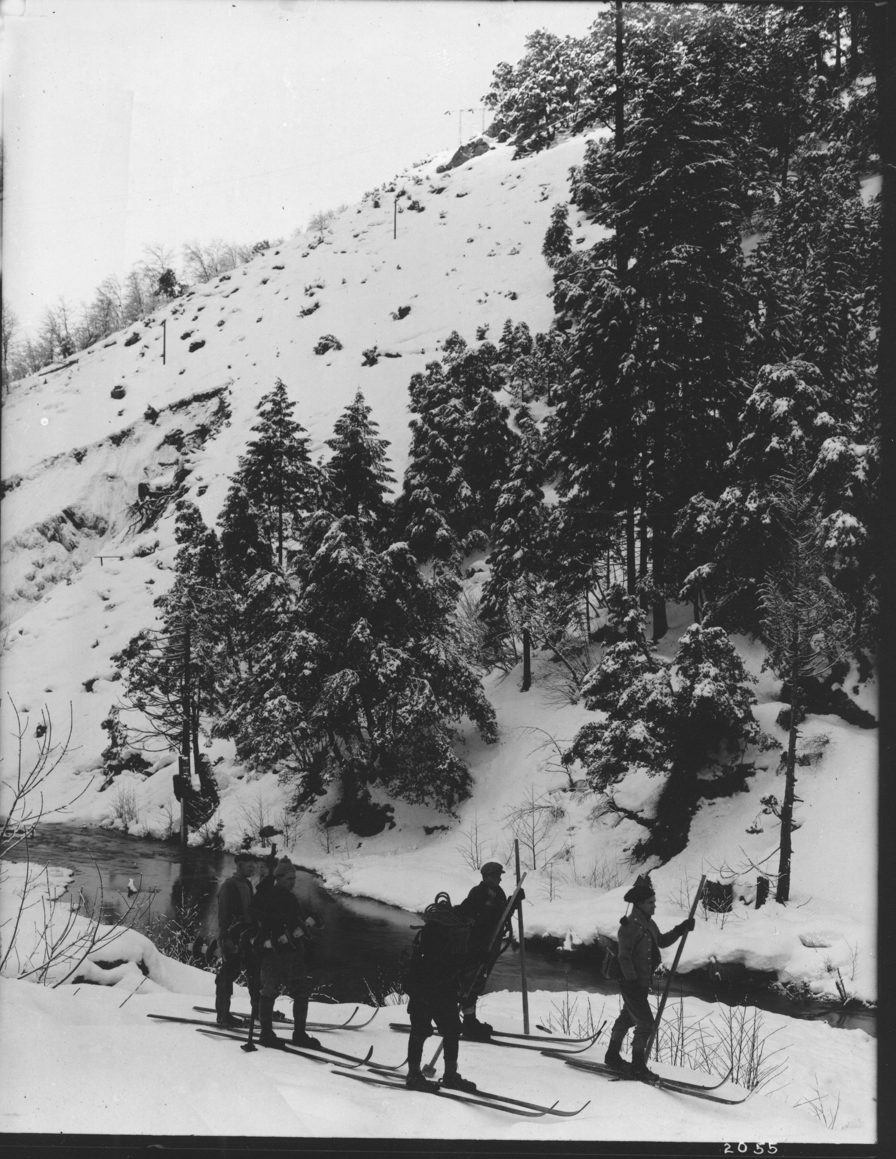
Measuring snowfall
Courtesy Gene Rose

Slide 19
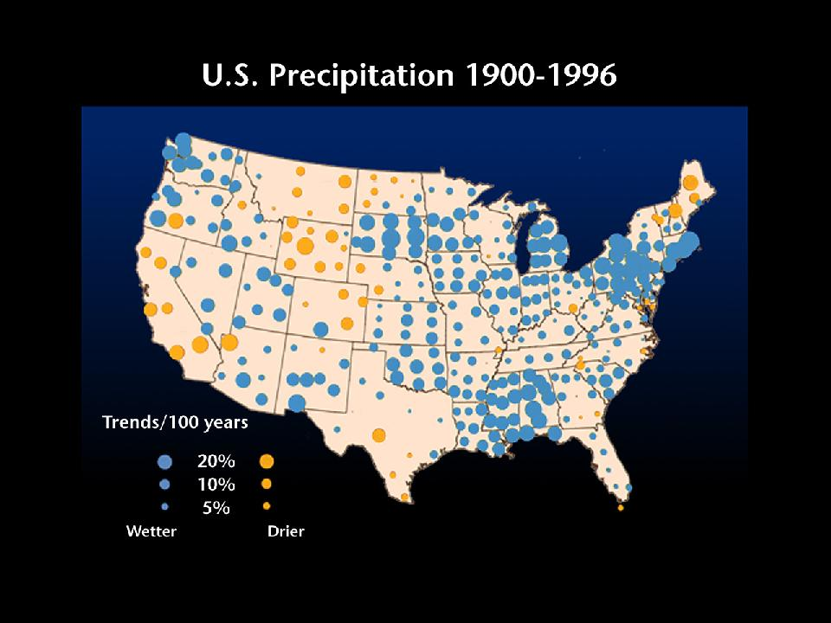
5% increase

Slide 20
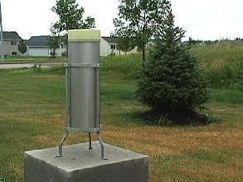
Standard rain gauge

Slide 21
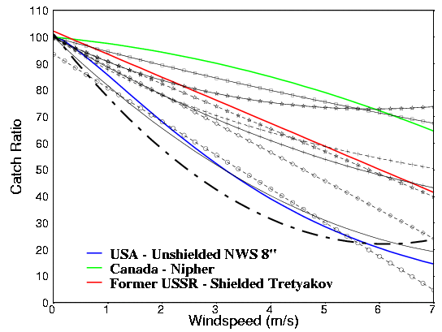
Undercatch of snow by precip gauges
Adam and Lettenmaier, 2002

Slide 22
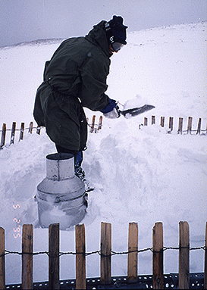
More snow than the gauge can handle
Niwot Ridge; 1995 snow storm
Wet, heavy snowfall where
accumulation was deeper than
the gauge was high

Slide 23
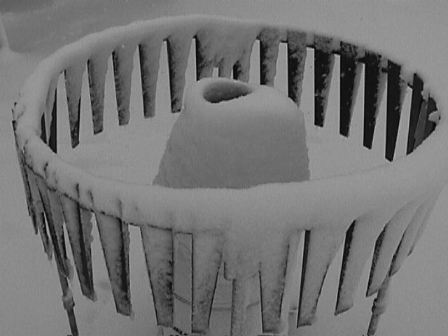
Br
Bridging at orifice leads to undercatch

Slide 24
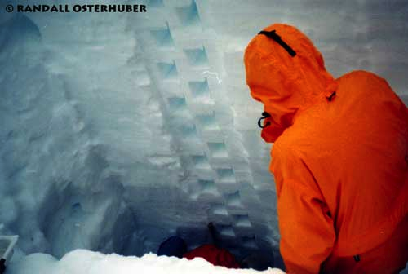
Snowpits
Most accurate measurement of snow depth, density, and SWE.
Obviously time-consuming.

Slide 25
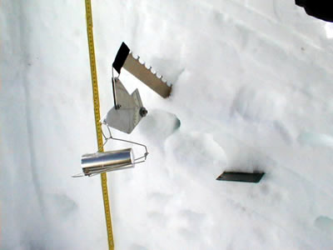
Snow density: Sipre sampler

Slide 26
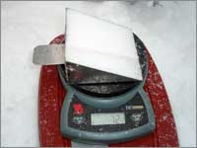
Snow density: Kelly cutter

Slide 27
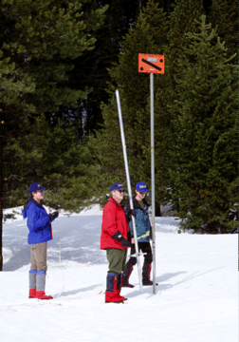
Snow Courses

Slide 28
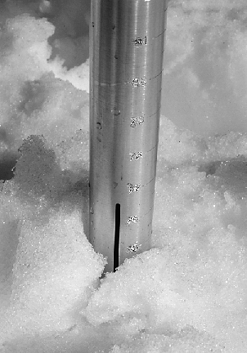
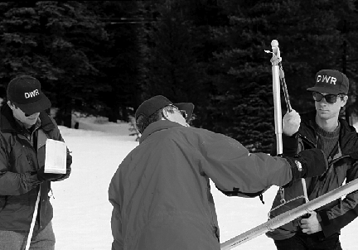
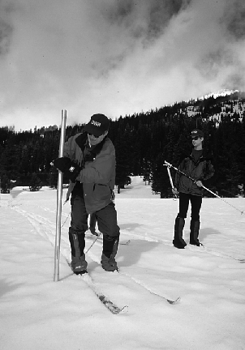
Federal or Mt. Rose snow sampler.

Slide 29
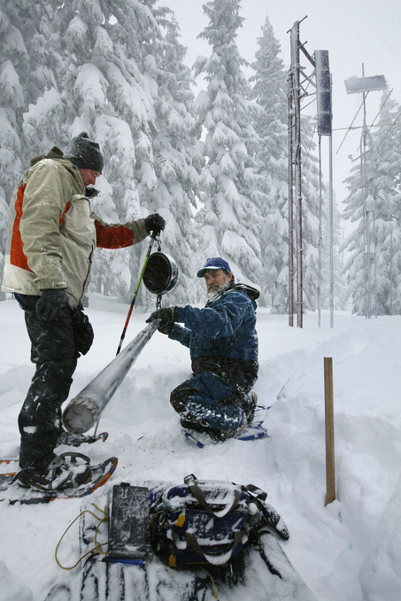
Federal sampler in action

Slide 30
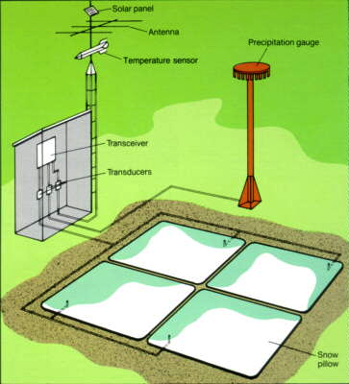
SnoTel Site
Measures only SWE
-no density
-no depth
Manometer measures
pressure
Manual calibration
with Mt Rose
sampler

Slide 31
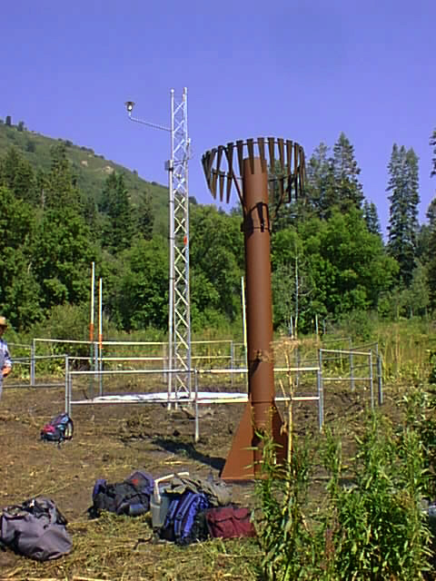
Enhanced SnoTel
Site

Slide 32
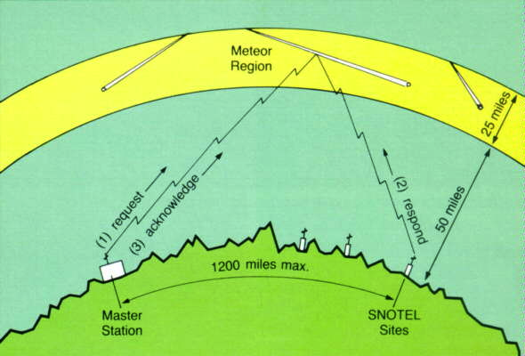
Meteor Burst telemetry

Slide 33
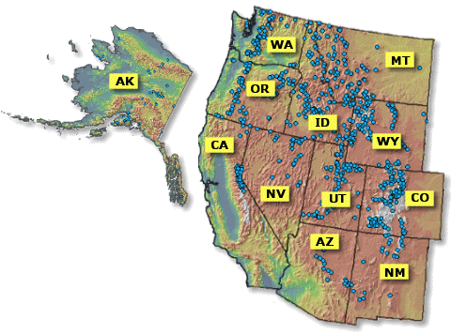

Slide 34
LIDAR
LIDAR (Light Detection and Ranging) is an optical remote sensing technology that measures properties of scattered light to find range and/or other information of a distant target.
The prevalent method to determine distance to an object or surface is to use laser pulses.

Slide 35
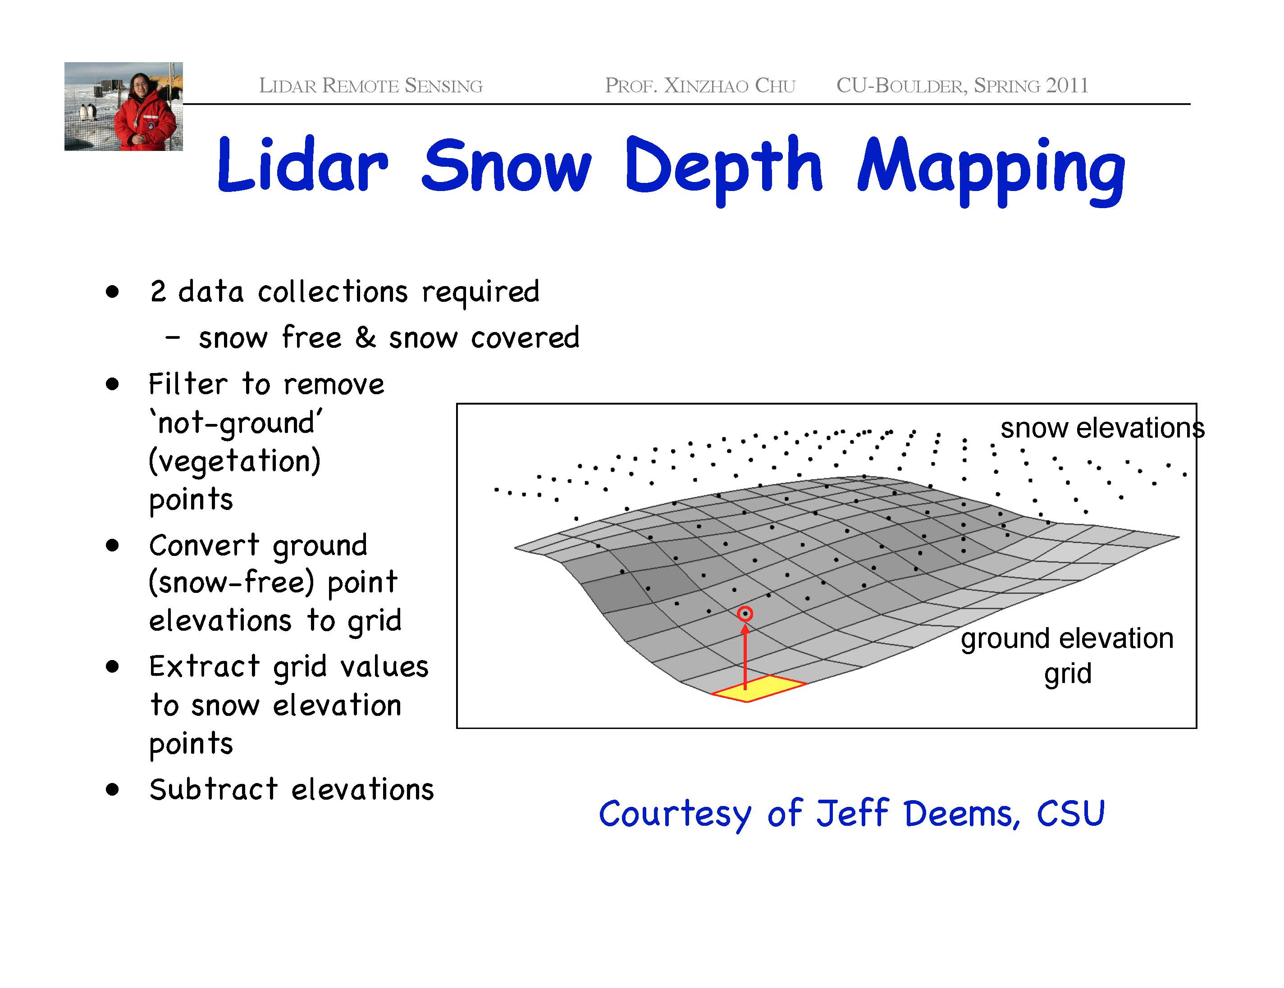
Accuracy 10-20 cms in all three directions

Slide 36
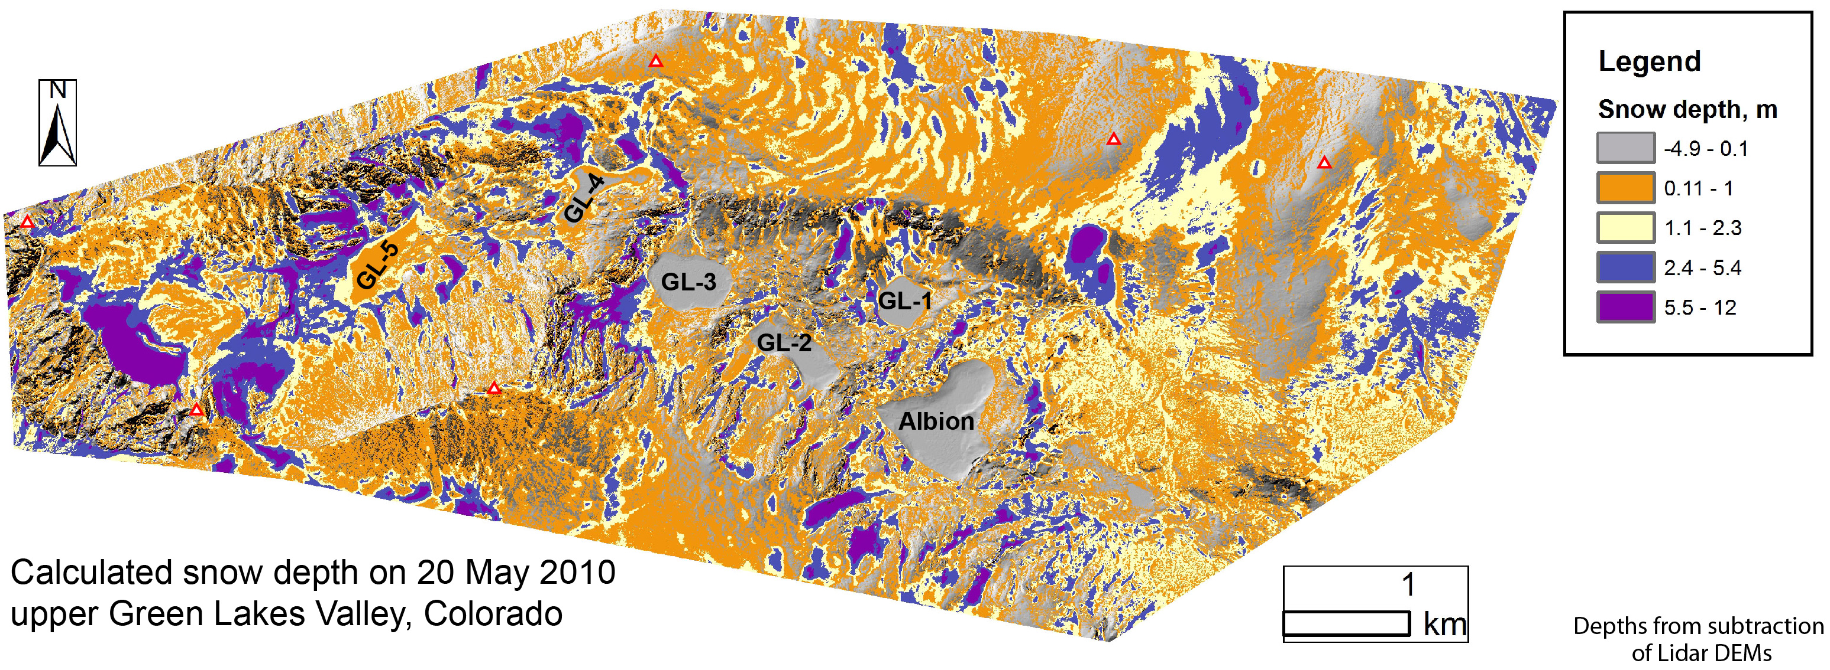
NWT LIDAR snow depth

Slide 37
GPS
Use the backscatter from a GPS antenna to measure changes in snow depth over time
Larson et al. 2009 example
Gutmann et al. 2011 example

Slide 38
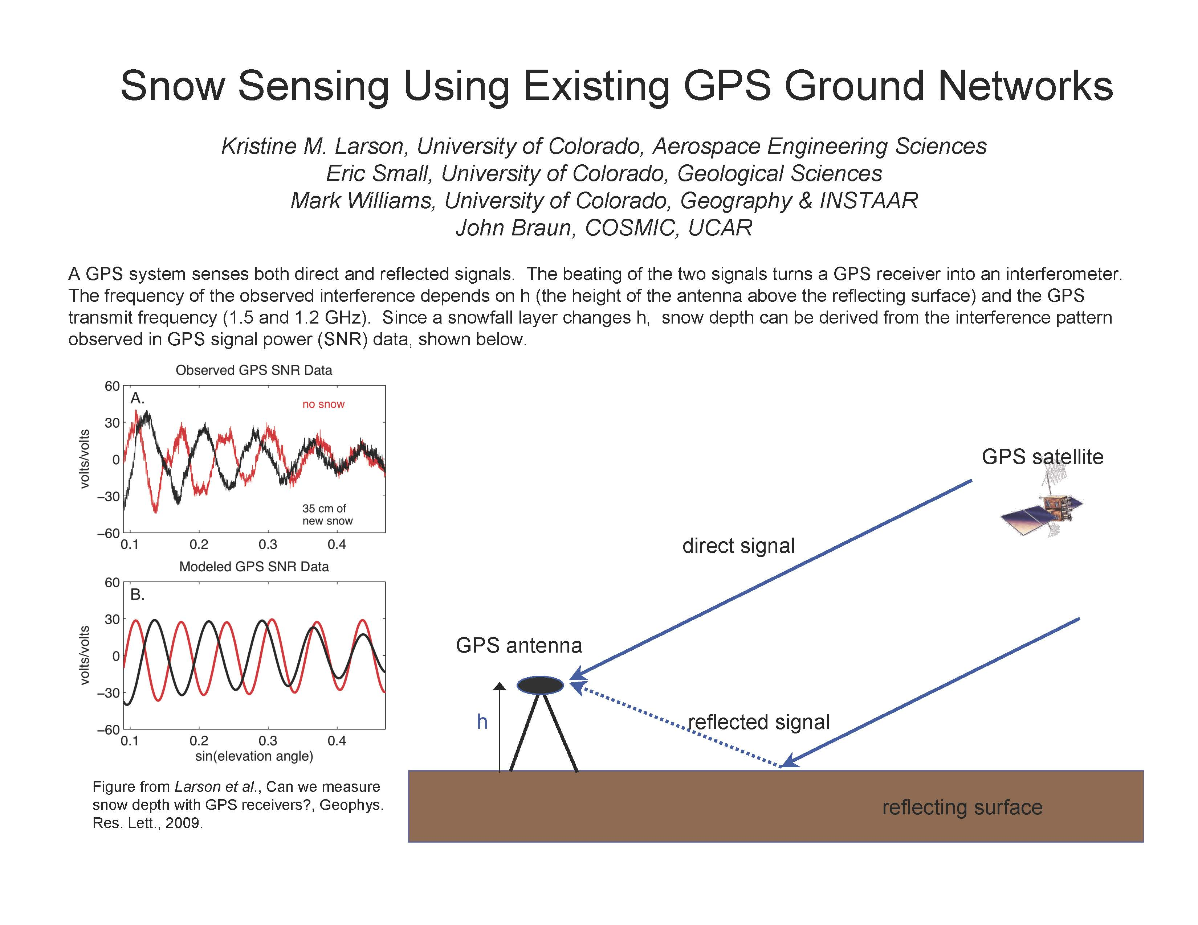

Slide 39
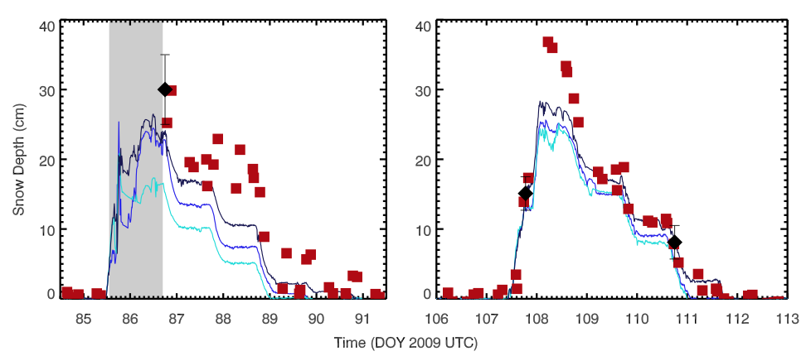
Snow depth derived from GPS (red squares), the three SR50 sonic snow depth sensors
(blue lines) and field measurements (black diamonds). Bars on field observations are one
standard deviation. GPS snow depth estimates during the first storm (day of year 85.5-86.5) are
not shown (gray region) because the SNR data indicate that snow was on top of the antenna
Larson et al. 2009.

Slide 40
GPS home site
http://xenon.colorado.edu/portal

Slide 41
Stream flow
Stream flow is a fundamental property that affects channel shape and the diversity of stream habitats, the flux of nutrients and pollutants, and the frequency and severity of floods.
Stream flow is controlled by such watershed variables as size, topography, geology, land use and presence of wetlands, as well as climatic variables such as rainfall, snow cover and temperature.

Slide 42
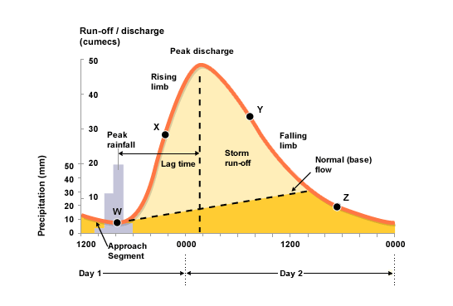
Unit hydrograph
http://www.bbc.co.uk/bitesize/higher/geography/physical/hydrosphere/revision/1/

Slide 43
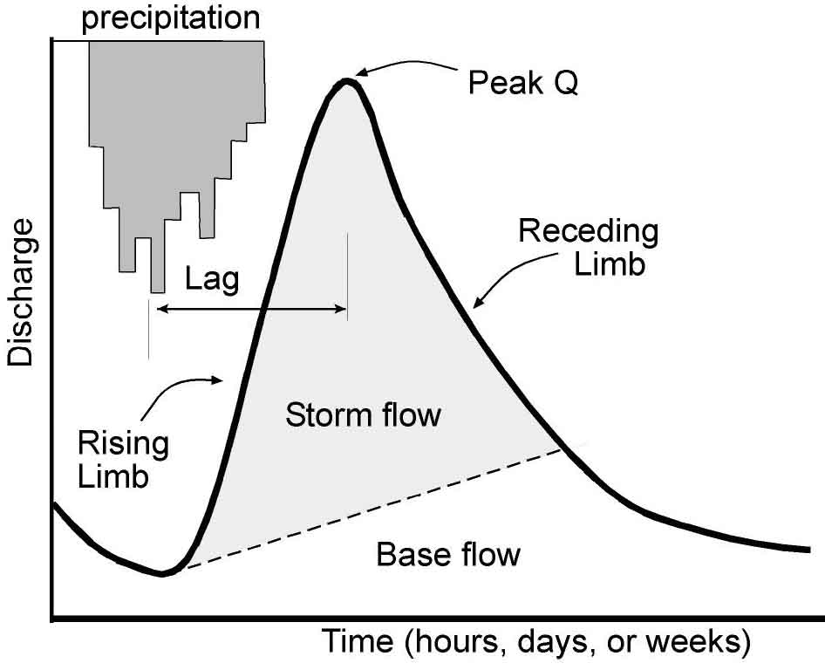
Hortonian overland flow

Slide 44
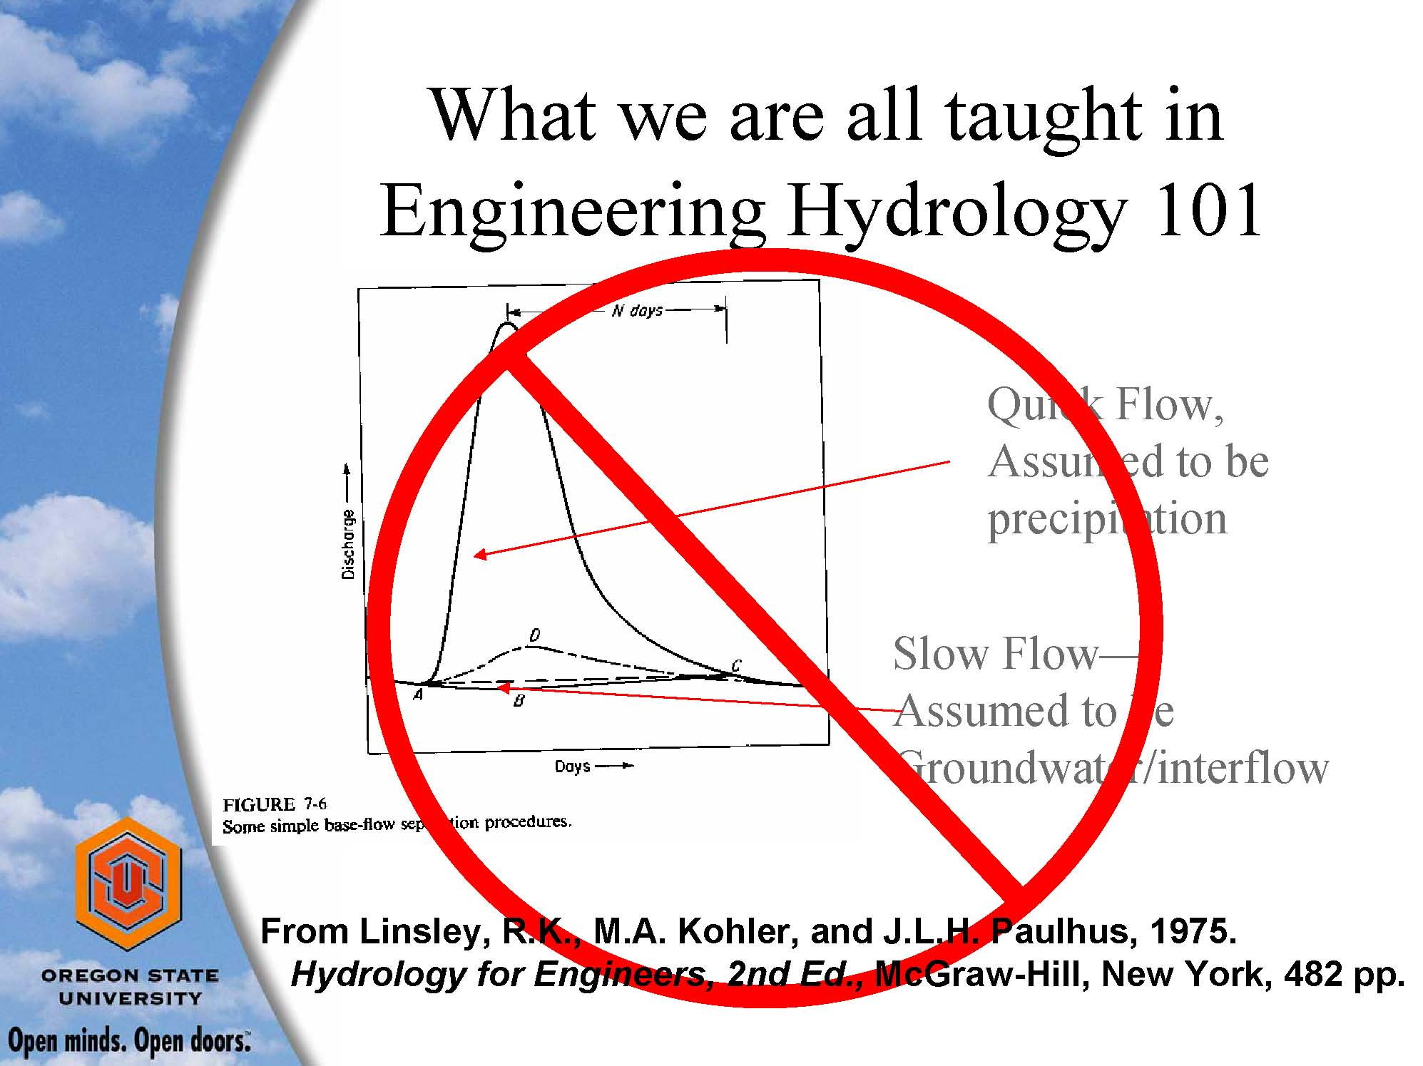

Slide 45
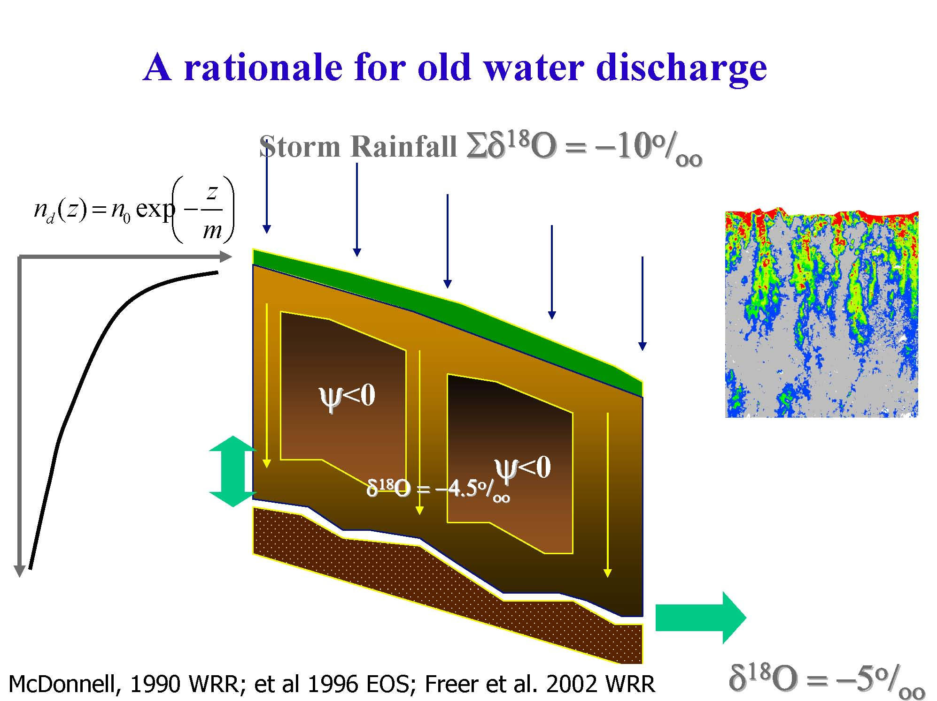

Slide 46
Snowmelt delivers water when we need it in the spring and summer
Isotopes show that groundwater
Much more important than previously thought

Slide 47
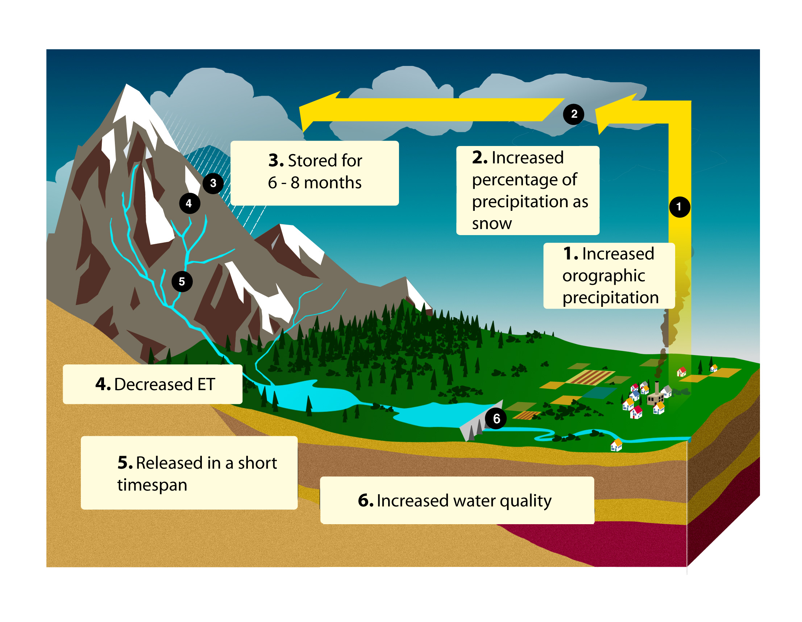
Mountains as Water Towers

Slide 48
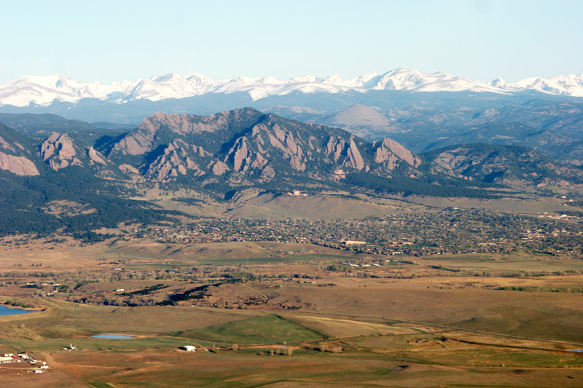
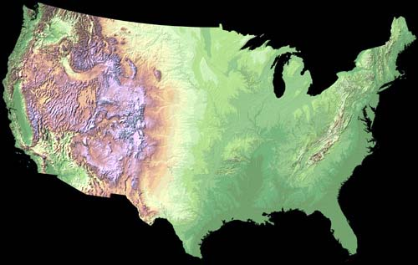
Image courtesy of NCAR

Slide 49
CLIMATE
&
ECOLOGICAL
ZONES
Alpine
4000 m
85% snow
Sub-alpine
3400 m
Montane
2900 m
59% snow
Foothills
2600 m
Plains
1500 m
Image courtesy of NCAR
Notes:
Ecological gradient across elevation
Gradient in precipitation amount (highest in the alpine) and proportion of snow (highest in the alpine)
Less known about lower elevations – i.e., montane which is at snowline. Snowline might shift in response to climate change.
49

Slide 50
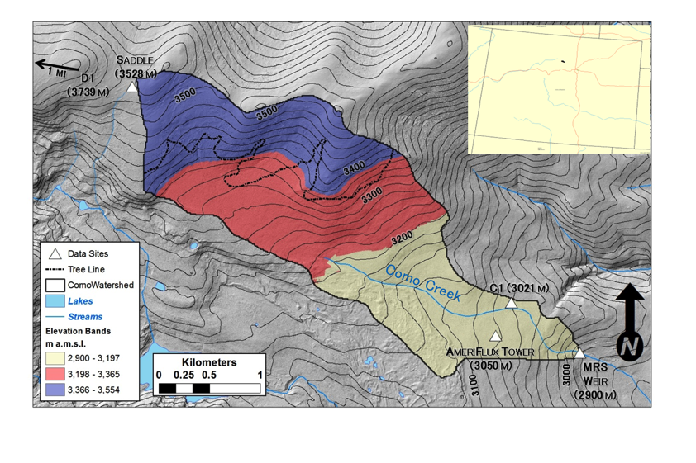
Water balance, Como Creek,

Slide 51
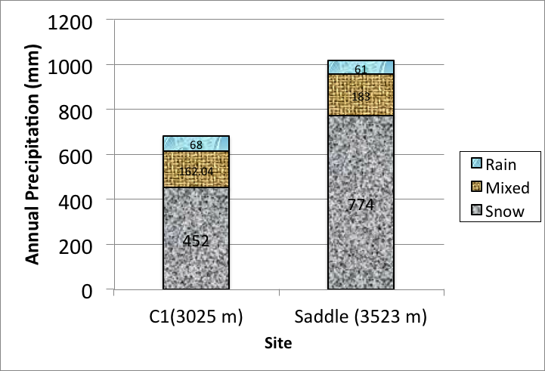
Precipitation increases with elevation

Slide 52
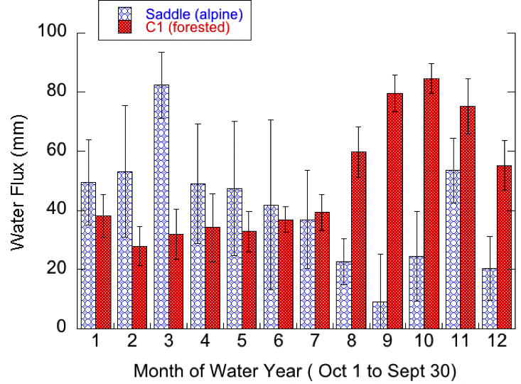

Slide 53
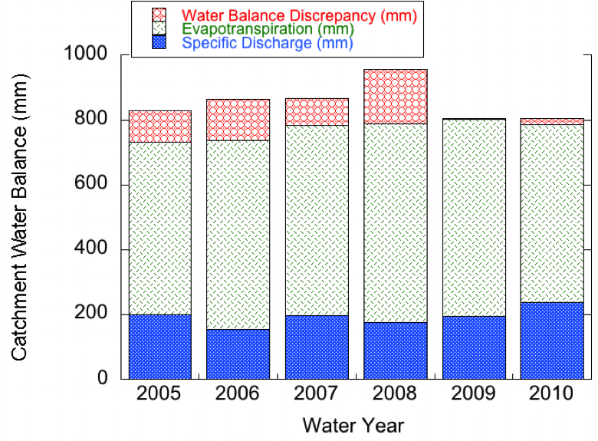

Slide 54
Image courtesy of NCAR

Slide 55
CLIMATE
&
ECOLOGICAL
ZONES
Alpine
4000 m
85% snow
Sub-alpine
3400 m
Montane
2900 m
59% snow
Foothills
2600 m
Plains
1500 m
Image courtesy of NCAR
Notes:
Ecological gradient across elevation
Gradient in precipitation amount (highest in the alpine) and proportion of snow (highest in the alpine)
Less known about lower elevations – i.e., montane which is at snowline. Snowline might shift in response to climate change.
55

Slide 56
Specific discharge elevation gradient
Williams et al., 2011

Slide 57
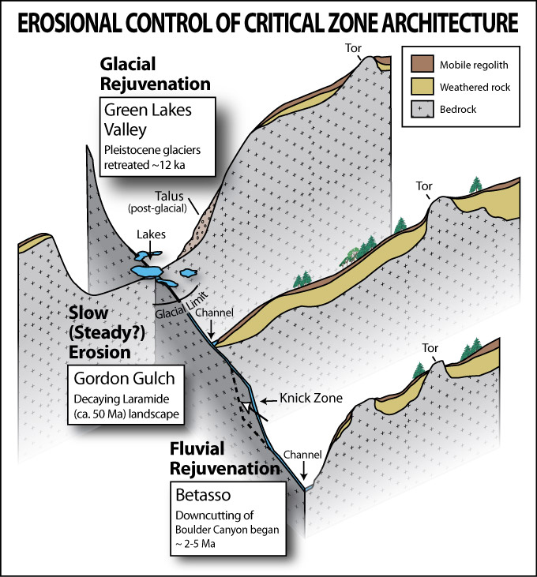
Subsurface reservoir storage
Runoff
Efficiency
%
87.7
20.0
37.7
12.2
Subsurface
Reservoir
(m³).
109,463
2,430
152
60
Como Creek
Notes:
Reservoir in Alpine huge – high permeability and transmissivity in the talus slopes and fractured bedrock
Lower in montane maybe because it does not get filled without a sufficient snowmelt pulse or it is just not present
Subsurface sp discharge: Bet N/A, GG 179 mm, Como 85 mm, GL4 772 mm

Slide 58
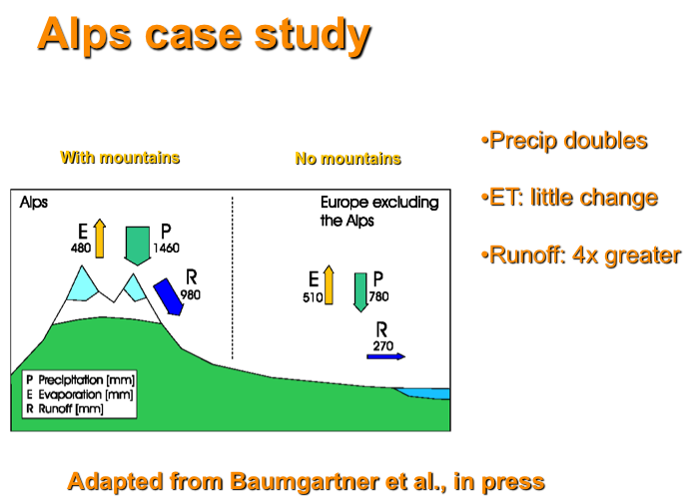

Slide 59
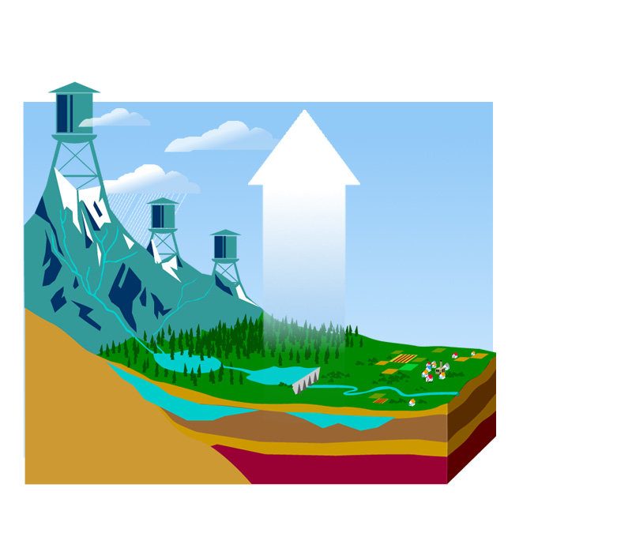

Slide 60
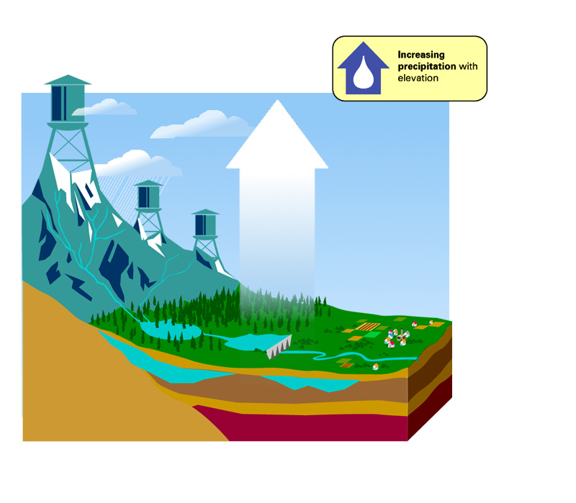

Slide 61
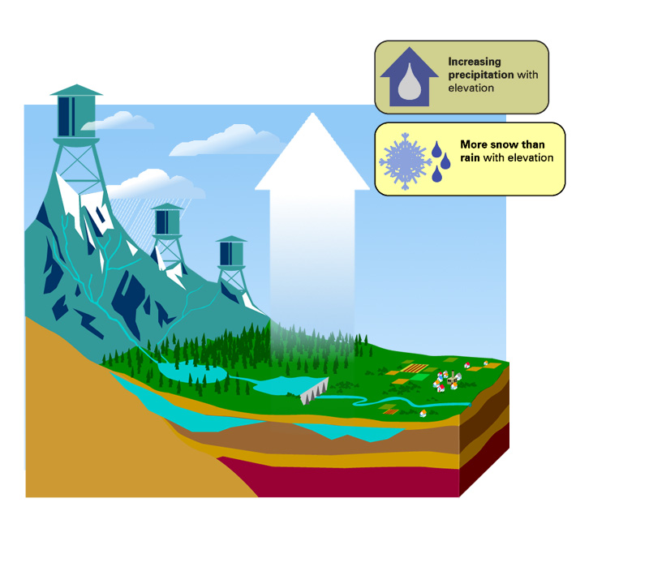

Slide 62
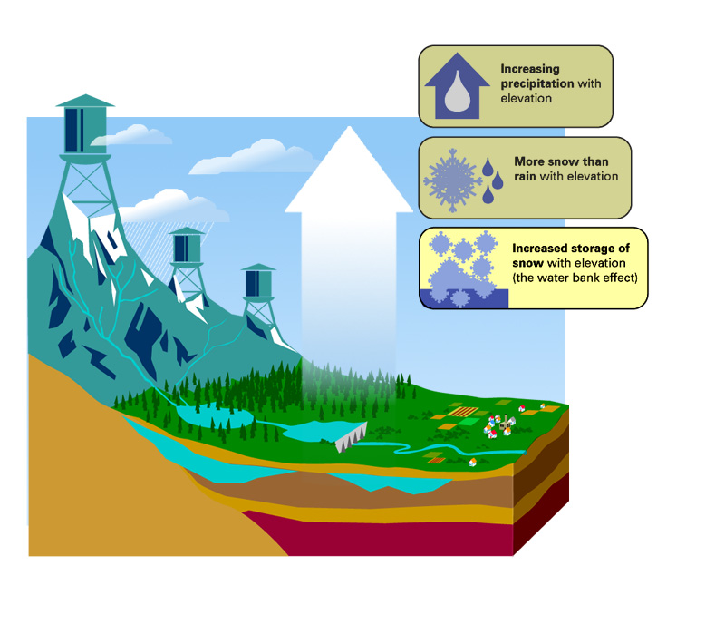

Slide 63
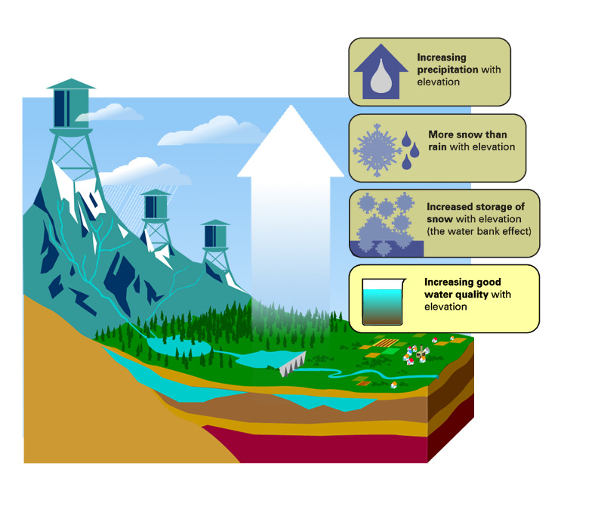

Slide 64
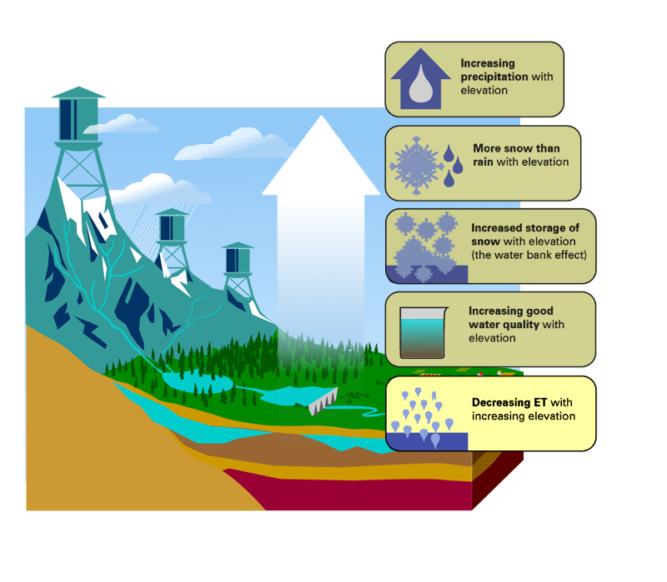

Slide 65
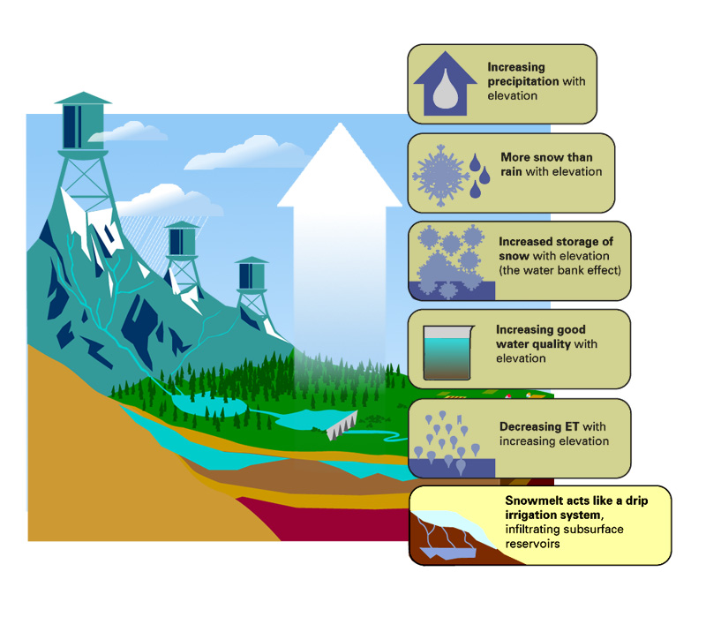

Slide 66
