Slide 1
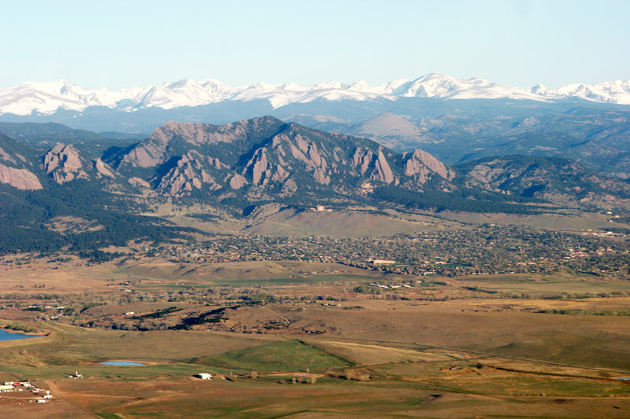
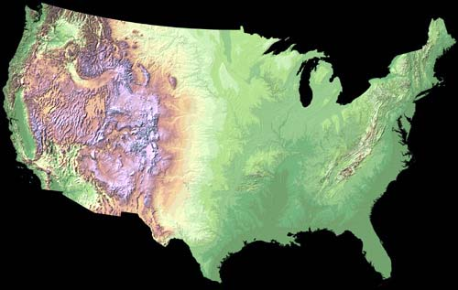
LTER Mountain Initiative: Resilience and Sustainability of Complex Mountain Landscapes
Organizations: US LTER, ILTER, MRI, LTER Europe, GBMA, and CML RCN

Slide 2
Primary Objective and Outcome
To address the issues of vulnerability, resilience, and sustainability of natural and human systems in complex mountain landscapes.
LTER and out-of-networks cross-site collaborations and global initiatives

Slide 3


A High mountain LTER Network
Laszlo Nagy, Eva Spehn, Mark Williams, Francisco Bonet, Patrick Bourgeron
http://gmba.unibas.ch/mountainLTER/mountainLTER.htm

Slide 4
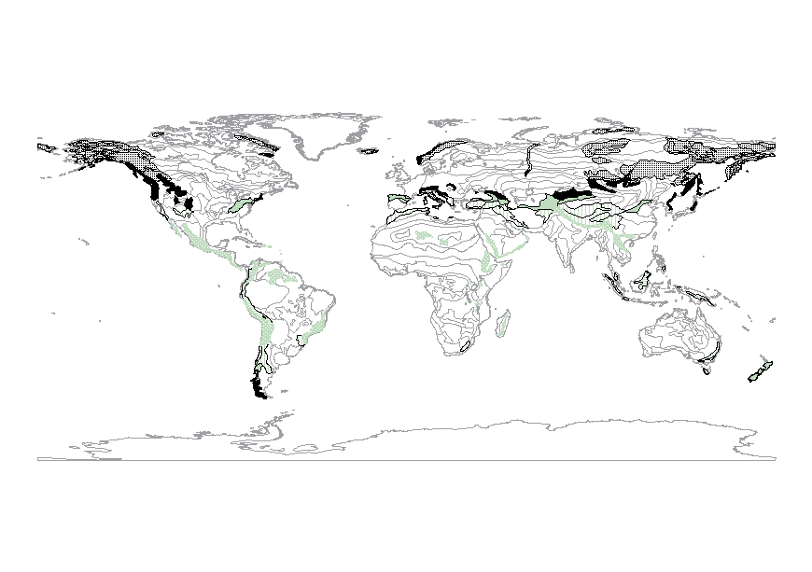
The Diversity of Mountains (Environmental Contrasts / Gradients) – the need for a network of sites
Temperature seasonality
  Aseasonal -> seasonal
Precipitation
  Arid -> perhumid
Land use history
  None -> long / intensive
Geological history
  bedrock (Ca vs. Si)
Glaciation history
  (+ / -)
  Consequence: differences in ecosystem structure
  and functioning
http://gmba.unibas.ch/mountainLTER/mountainLTER.htm

Slide 5
High mountain LTERs
Worldwide network, administered by GMBA
Identify and involve suitable candidate sites (history of research, complementarity)
Initial synthesis of the current state-of-the-art – ‘Monographs in Alpine Long-term Ecological Research’, a series to be published in Plant Ecology & Diversity – first issue: Niwot Ridge 1995-2010 (eds. Williams M., Bowman W., Bourgeron P.)
http://gmba.unibas.ch/mountainLTER/mountainLTER.htm

Slide 6
Activities 2010-2012
Session at GMBA Science Conference 2010 - (LTERs in the Alpine and their influence on biodiversity research)
Meeting of International working group on mountain LTER sites, Lautaret 2011 - GMBA portal established: http://gmba.unibas.ch/mountainLTER/mountainLTER.htm
Estes Park, Colorado, LTER ASM 2012 – WG session on ‘Resilience and sustainability of complex mountain landscapes’: Work group established on ‘Classification of mountain ranges’
http://gmba.unibas.ch/mountainLTER/mountainLTER.htm

Slide 7
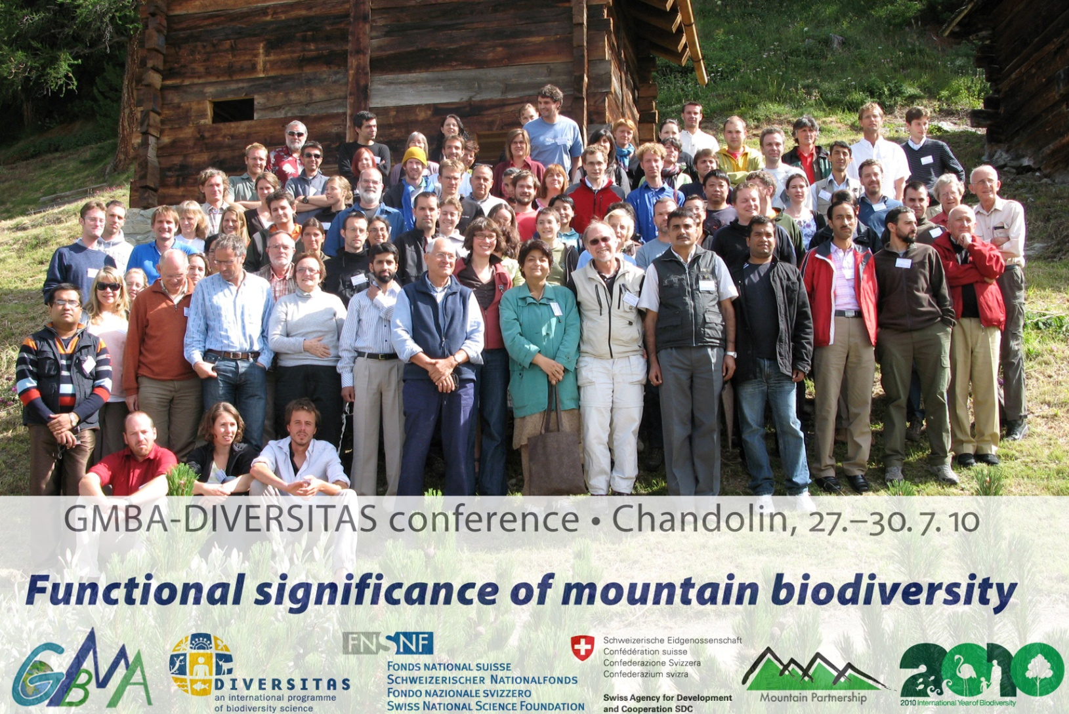
LTERs in the Alpine and their influence on biodiversity research
NWT LTER as a prototype for understanding the controls on alpine biodiversity: the challenge of converting long term monitoring into science (Williams M.)
Converting field data into knowledge: towards adaptive management in Sierra Nevada LTER site (Bonet F.)
LTER in the Austrian Central Alps: scientific relevance and outlook (Erschbamer B.)
Chandolin, 2010
http://gmba.unibas.ch/mountainLTER/mountainLTER.htm

Slide 8


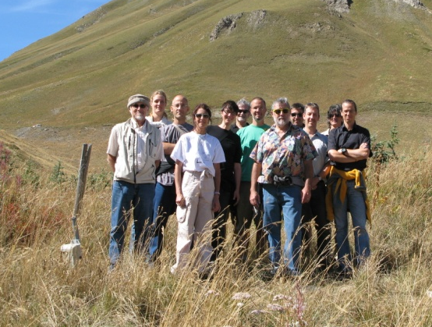
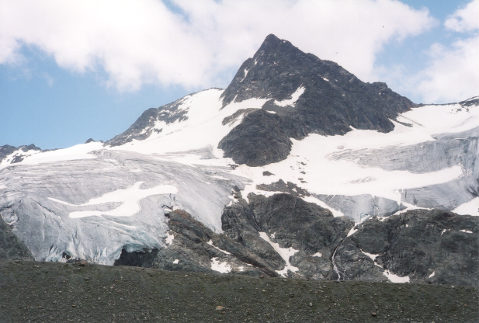
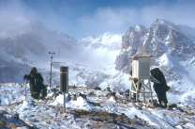
Global Network of alpine LTER sites
Lautaret, 2011
Nucleus of core sites to use common
protocols to ensure comparability of data
GMBA provides the framework and coordination
Niwot Ridge, Rocky Mountains USA
Sierra Nevada, Spain
Aosta valley, Italy
Lautaret, Grenoble, France
Tyrol, Austria
Furka region, Switzerland
www.gmba.unibas.ch
GMBA aims to:
● explore and explain the great biological richness of the mountains of the world
● increase the amount and quality of high quality geo-referenced data on mountain biodiversity
● provide input to policy makers and stakeholders for the conservation and sustainable use of mountain biodiversity
http://gmba.unibas.ch/mountainLTER/mountainLTER.htm

Slide 9
Workshop at ASM 2012 (LTER, ILTER, Mountain LTER, and the CLM RCN)http://asm2012.lternet.edu/working-groups/resilience-and-sustainability-complex-mountain-landscapes
Key research topics identified:
  Characterization of the global range of variability in mountain systems, including the elevation gradient: gradient analysis, classification, boundaries
  Characterization of the services (economic and otherwise) provided by mountain systems: global distribution, model(s)
  Land use
  Ecological legacies: imprints of legacies on system dynamics
  Atmospheric deposition
  Change in species distribution

Slide 10




Long-term ecological research (LTER):
the challenge of converting long term
monitoring into science
Mark Williams, University of Colorado

Slide 11
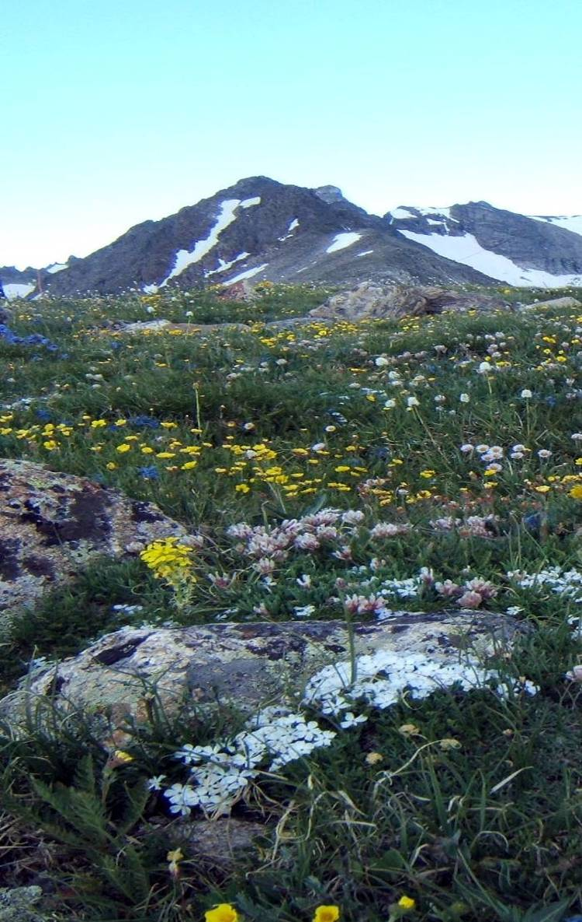
Outline
The need for long-term research
Niwot Ridge LTER examples
LTER program overview
Recommendations for developing long-term research programs

Slide 12
Duration of all observational and experimental studies
Eighty percent of studies in the ecological literature last less than three years
N = 623
From Tilman, D. 1989. Ecological experimentation: strengths and conceptual
problems. pp. 136-157. In Likens, G.E. (ed). Long-Term Studies in Ecology.
Springer-Verlag, New York.
Notes:
80% of studies in the ecological literature last less than three years
80% of studies in the ecological literature last less than three years

Slide 13

Only 10 percent of studies capture unusual events
Unusual events reset systems. Short-term studies initiated before and after a rare event are viewing different system states.
Variable
Time (yrs)
Notes:
Unusual events reset systems. Short-term studies initiated before and after a rare event are viewing different system states.

Slide 14
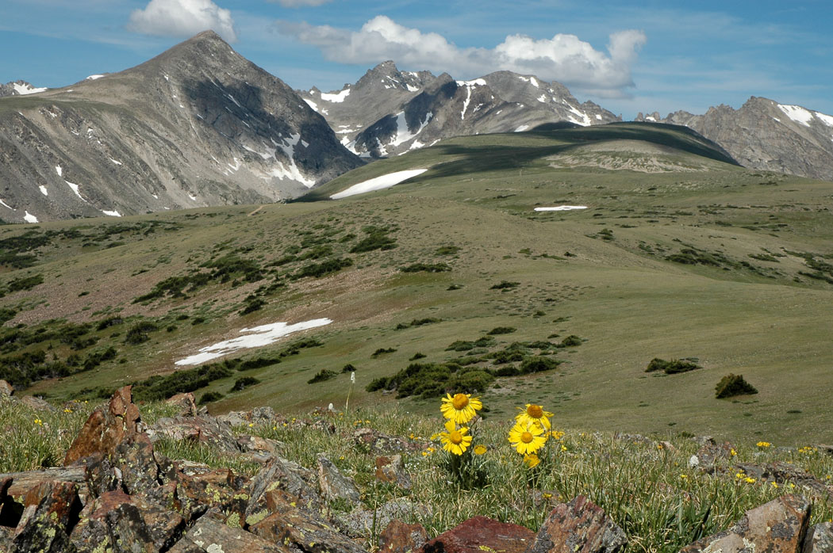
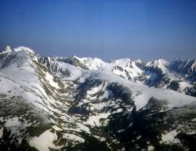
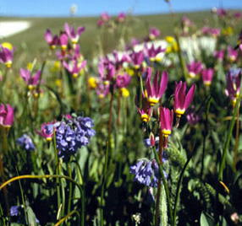
High-elevation areas are important bellwethers of global change:
we need long-term research

Slide 15
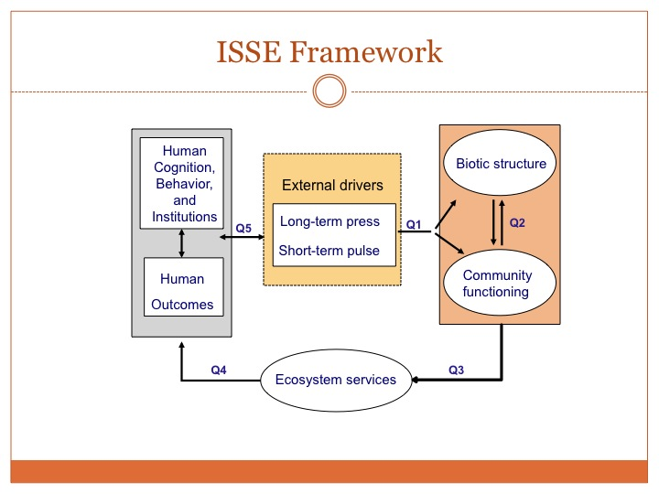

Slide 16
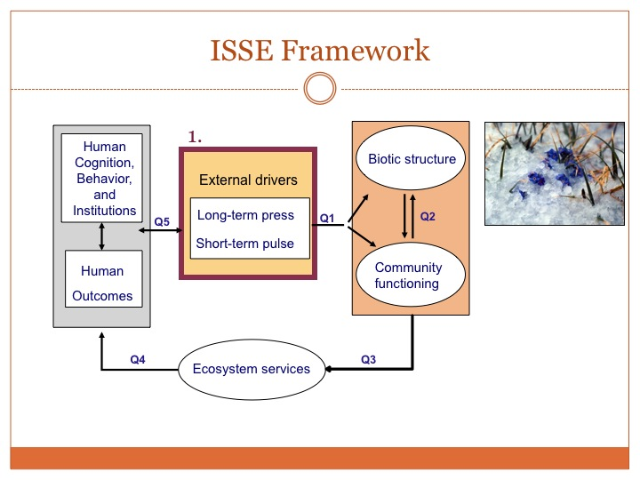

Slide 17
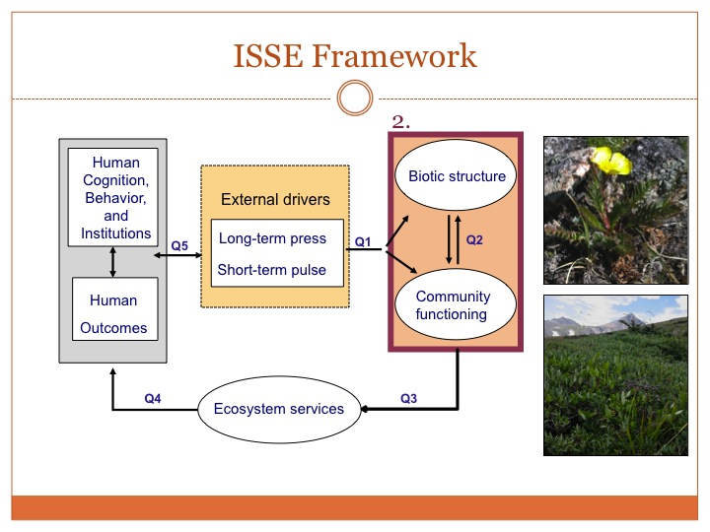

Slide 18
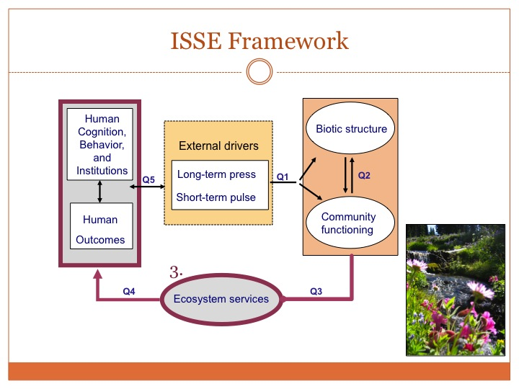

Slide 19
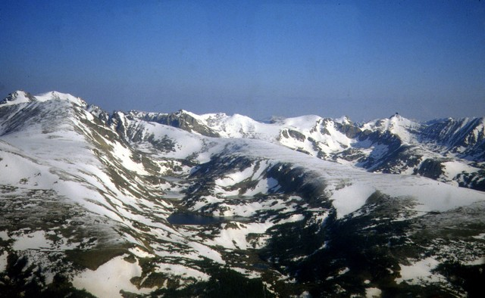
Glaciatedvalley
SADDLE

Slide 20
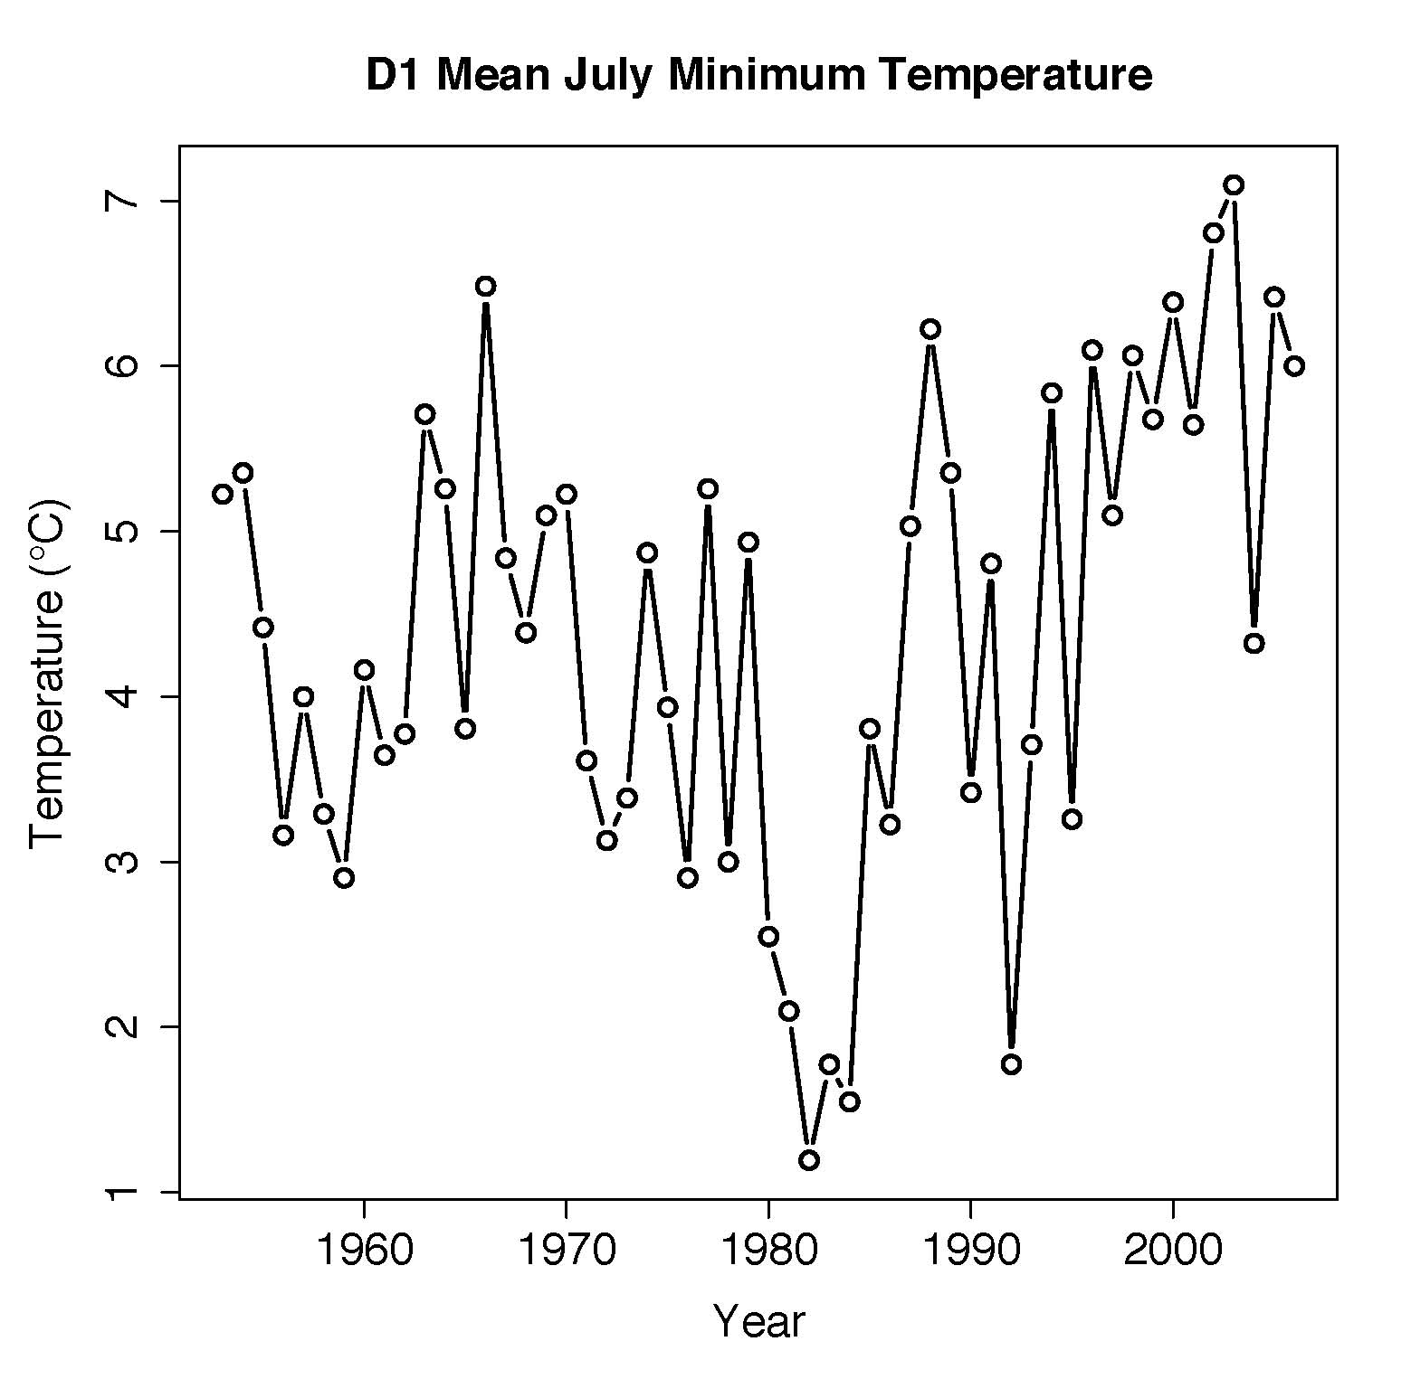
External Drivers: Temperature
Increasing air temperature since early 1980’s
Summer air temps warming fastest
Earlier lake ice-out
dates
5ºC increase in 25 years

Slide 21
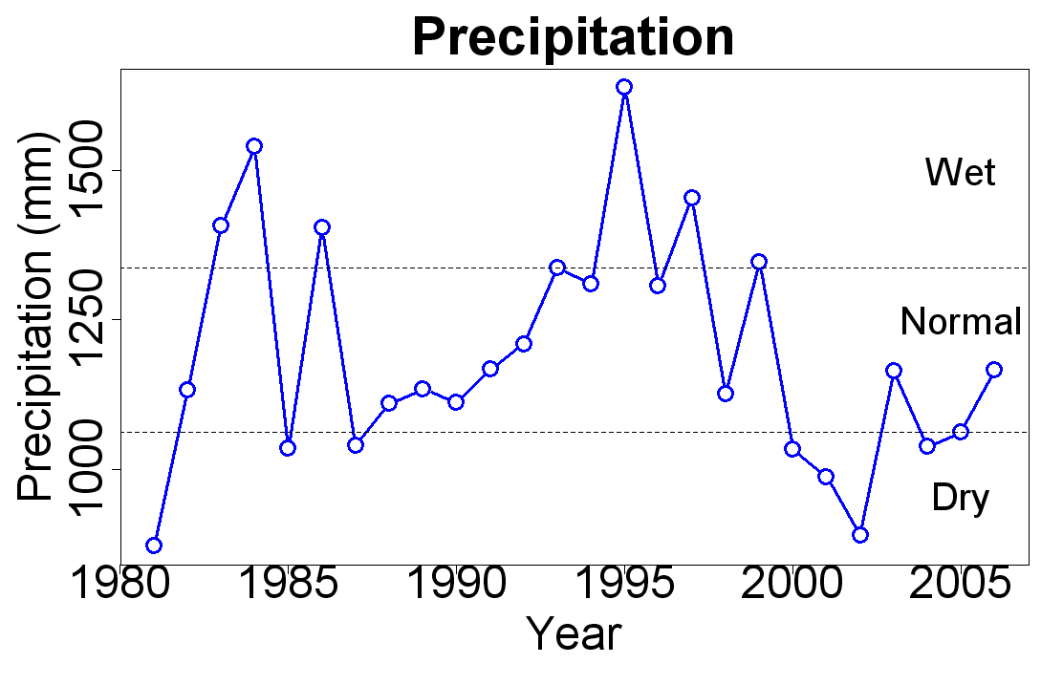
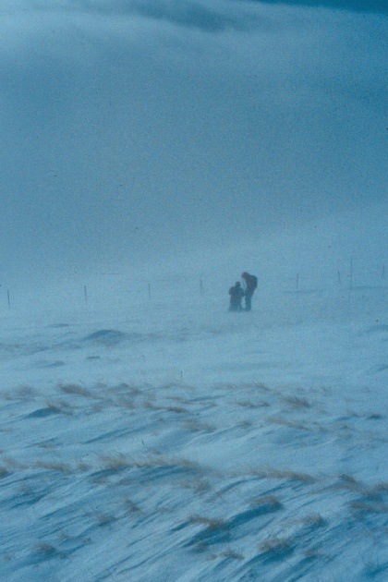
External Drivers: Precipitation
Greater precipitation with increasing elevation
Increases in the winter months (more snow)
Summer drought starting in 2000

Slide 22
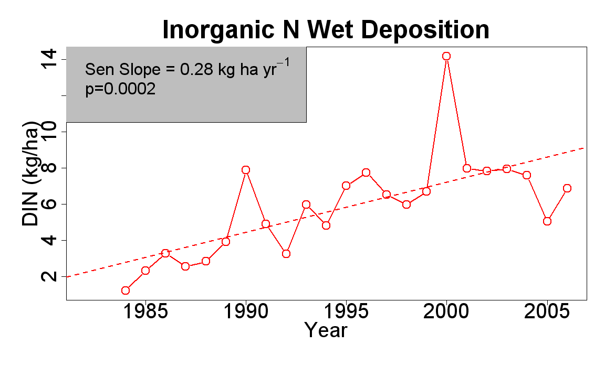
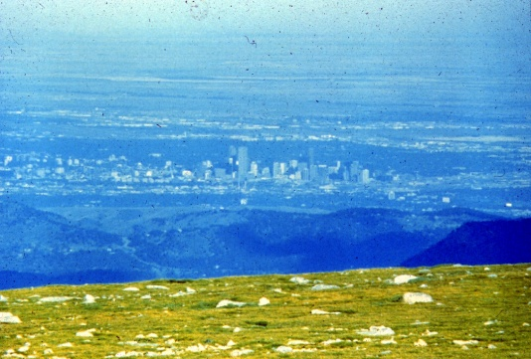
External Drivers: N deposition
Increased rates of N deposition (wetfall)
N loading increases, despite drought

Slide 23
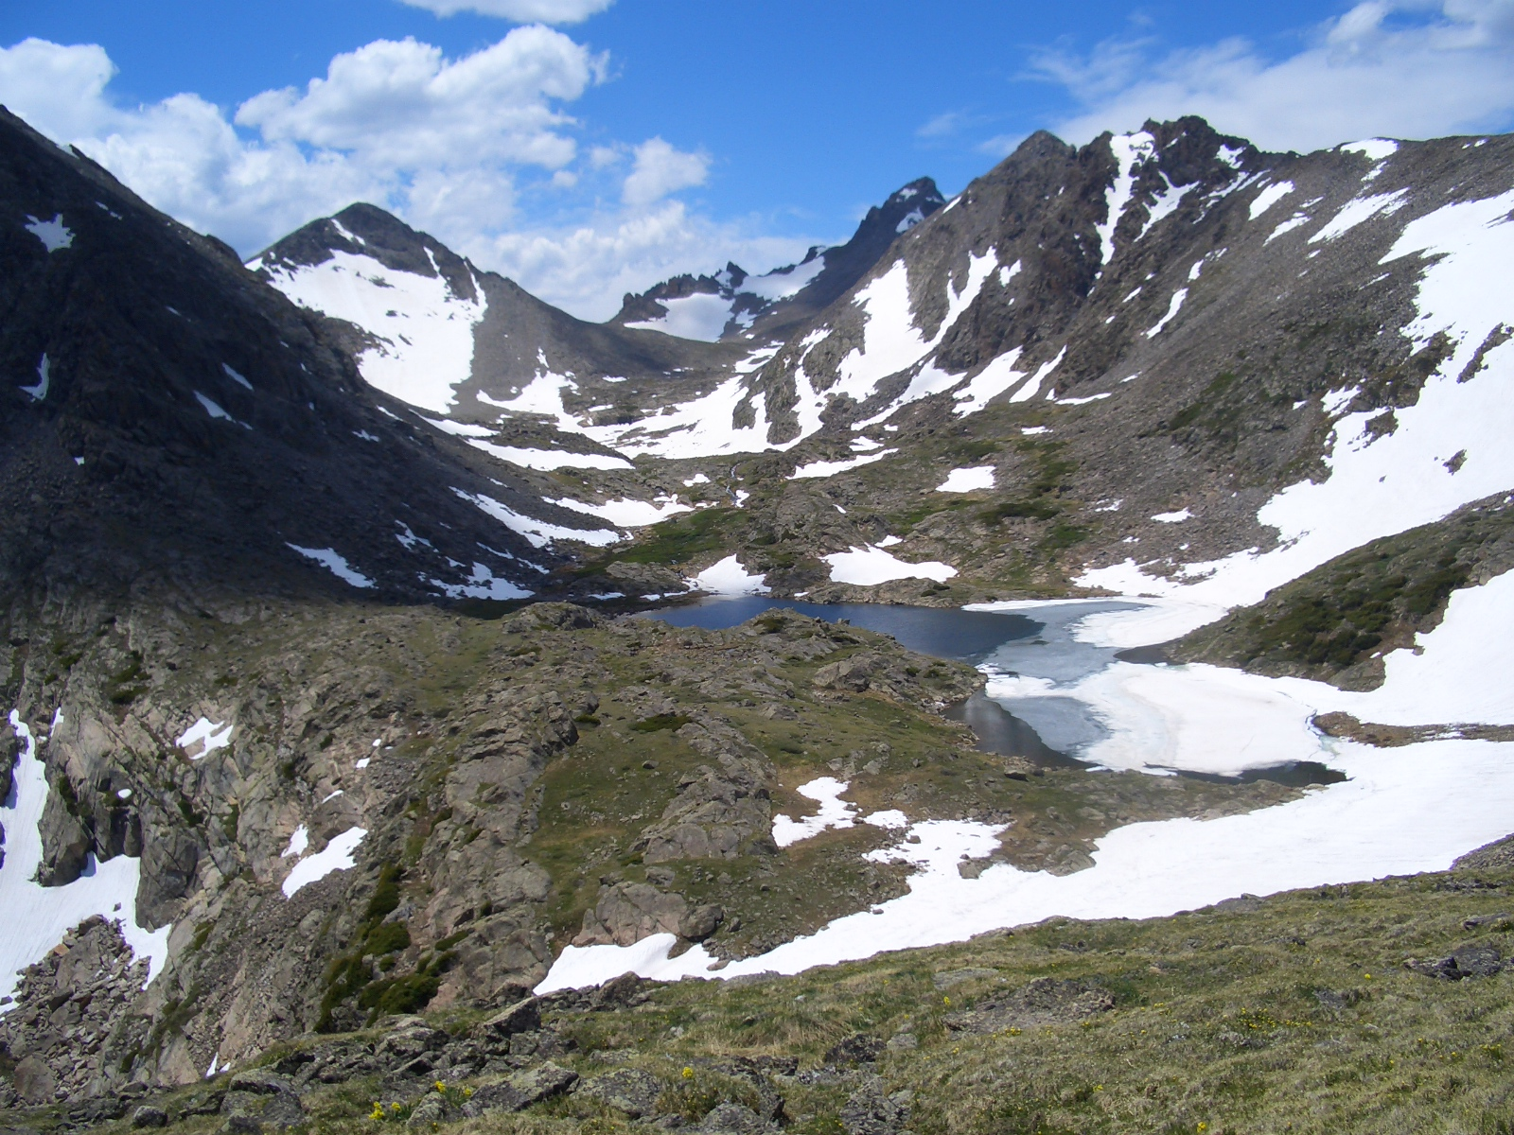
ARIKAREE GLACIER
D1 CLIMATE
ROCK GLACIER
GREEN LAKE 4
3,600 m

Slide 24
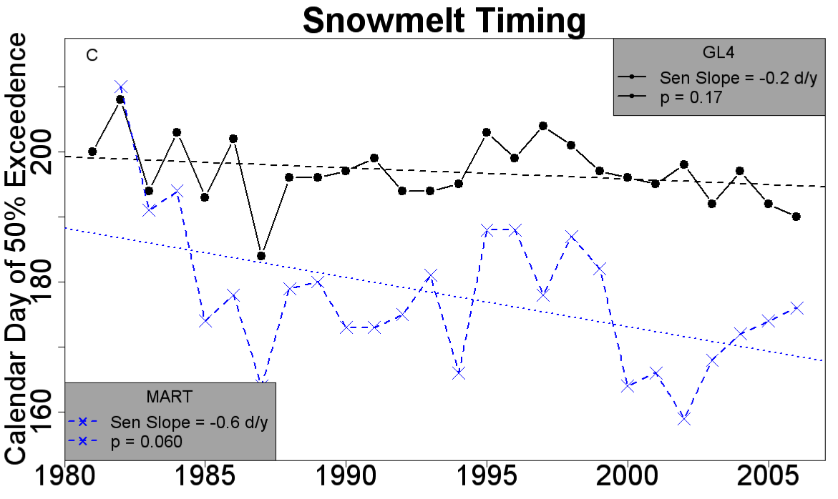
Earlier Snowmelt 2-6 days decade⁻¹

Slide 25
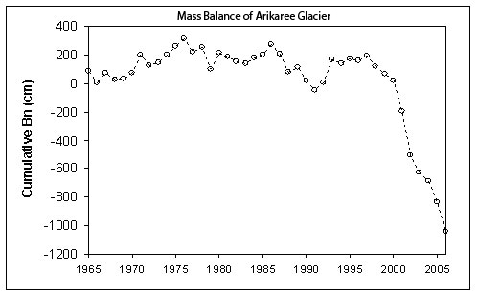
Arikaree glacier is dying
Drought
Tipping point
Arikaree Glacier: Mass balance (Bn), cm water equivalent.

Slide 26
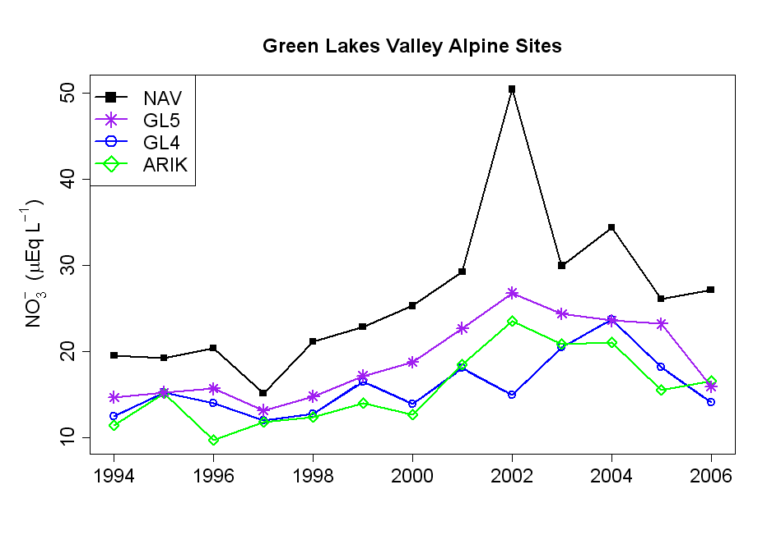
N dep + warming T = N saturation
N Critical load:
Aquatic
4 Kg N/ ha/ yr
Annual VWM concentrations of nitrate increase at all stream sites

Slide 27
Stoichiometric controls on N-cycling
Scatterplot of NO3- vs. DOC: NO3- ratio
for eight sites in Green Lakes Valley.
Williams et al. 2011

Slide 28
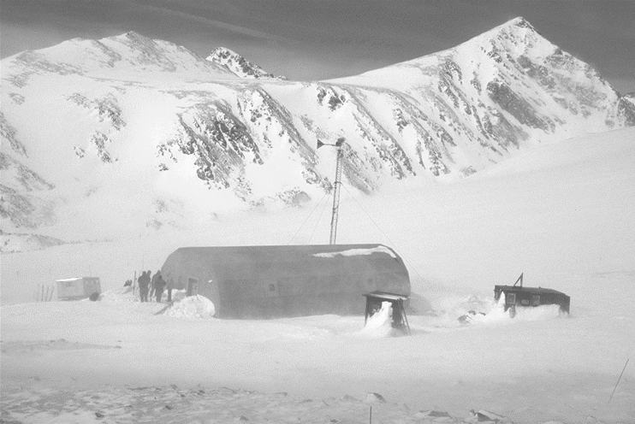
Saddle site

Slide 29
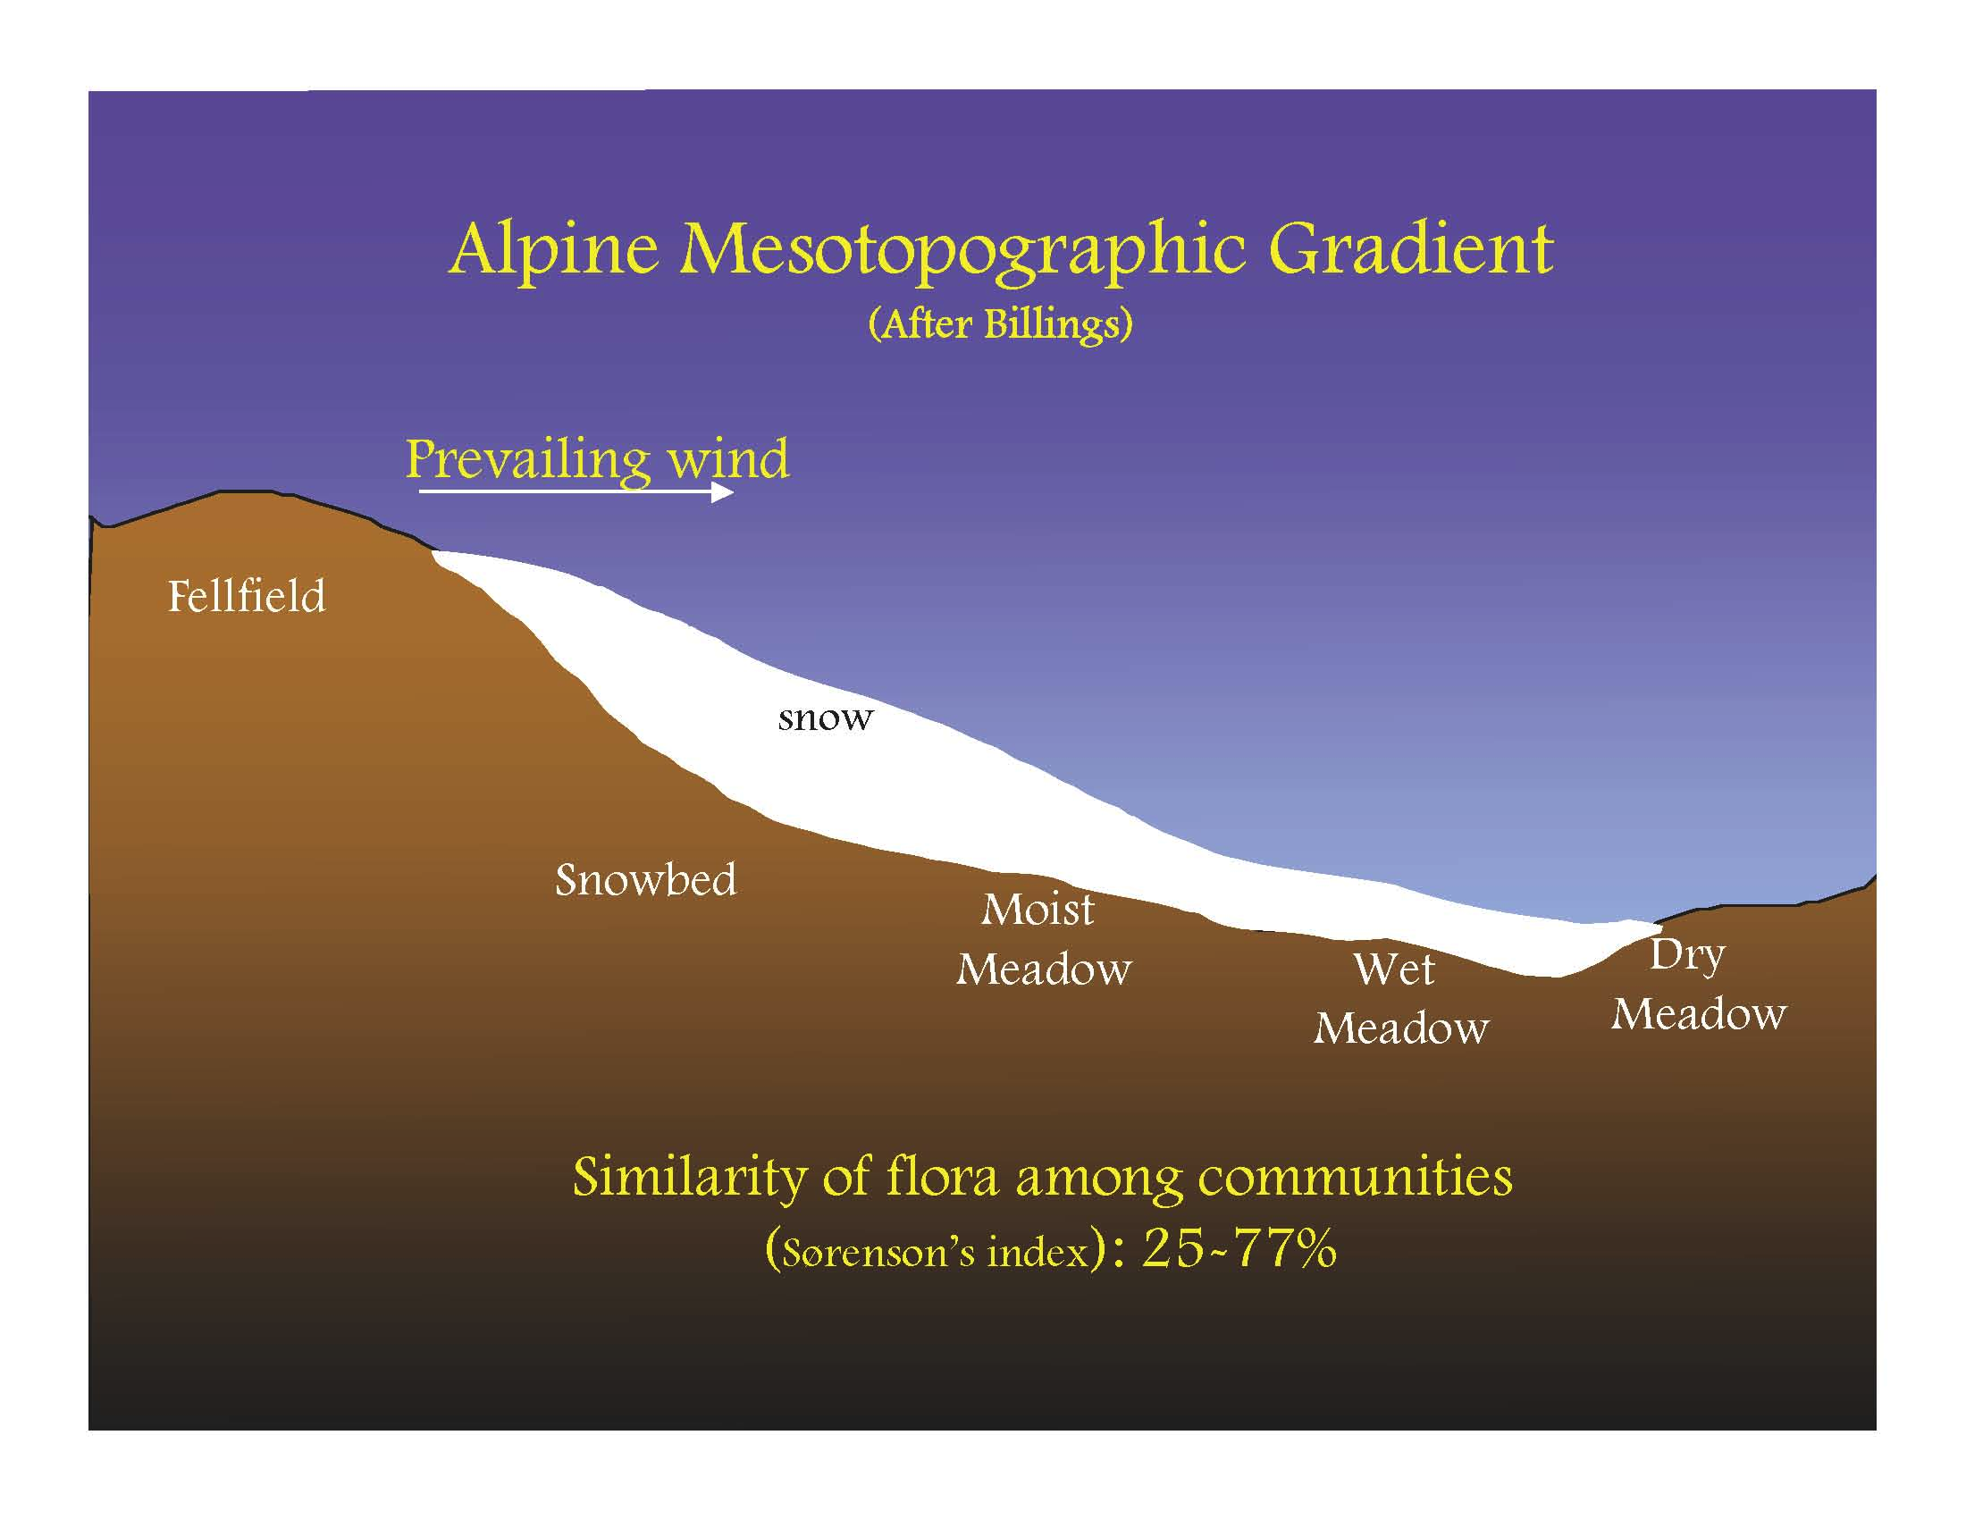

Slide 30
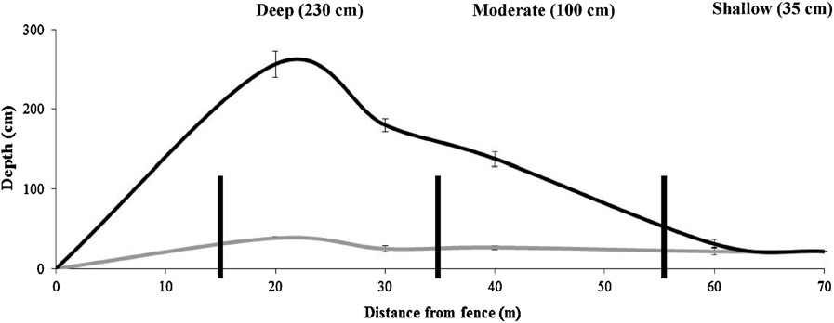
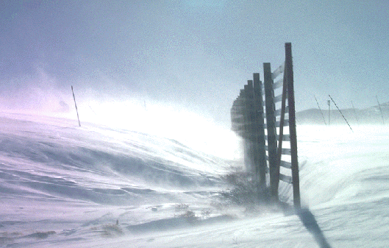
Freppaz et al. in press

Slide 31
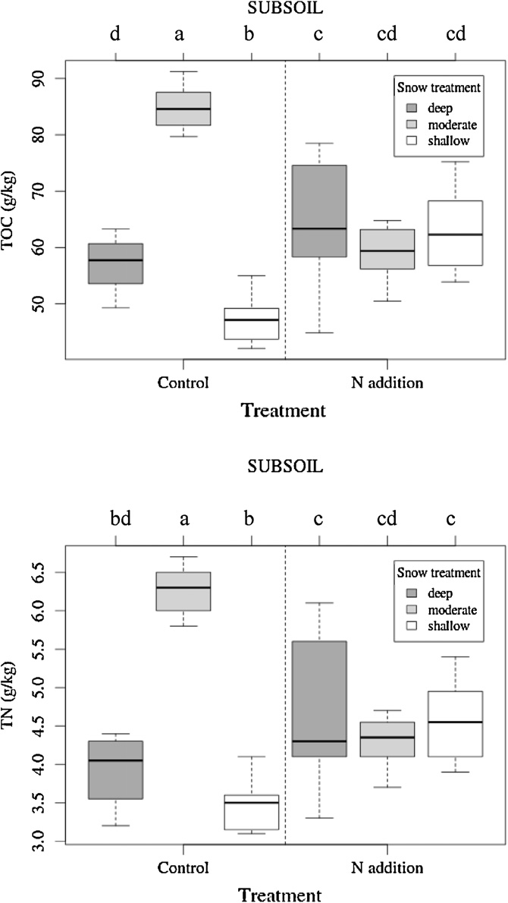
Freppaz et al. in press
Changes in snow depth change
soil properties more than
N-addition experiments
TOC and TN increase with
moderate snow depth and
decrease with more or less snow

Slide 32
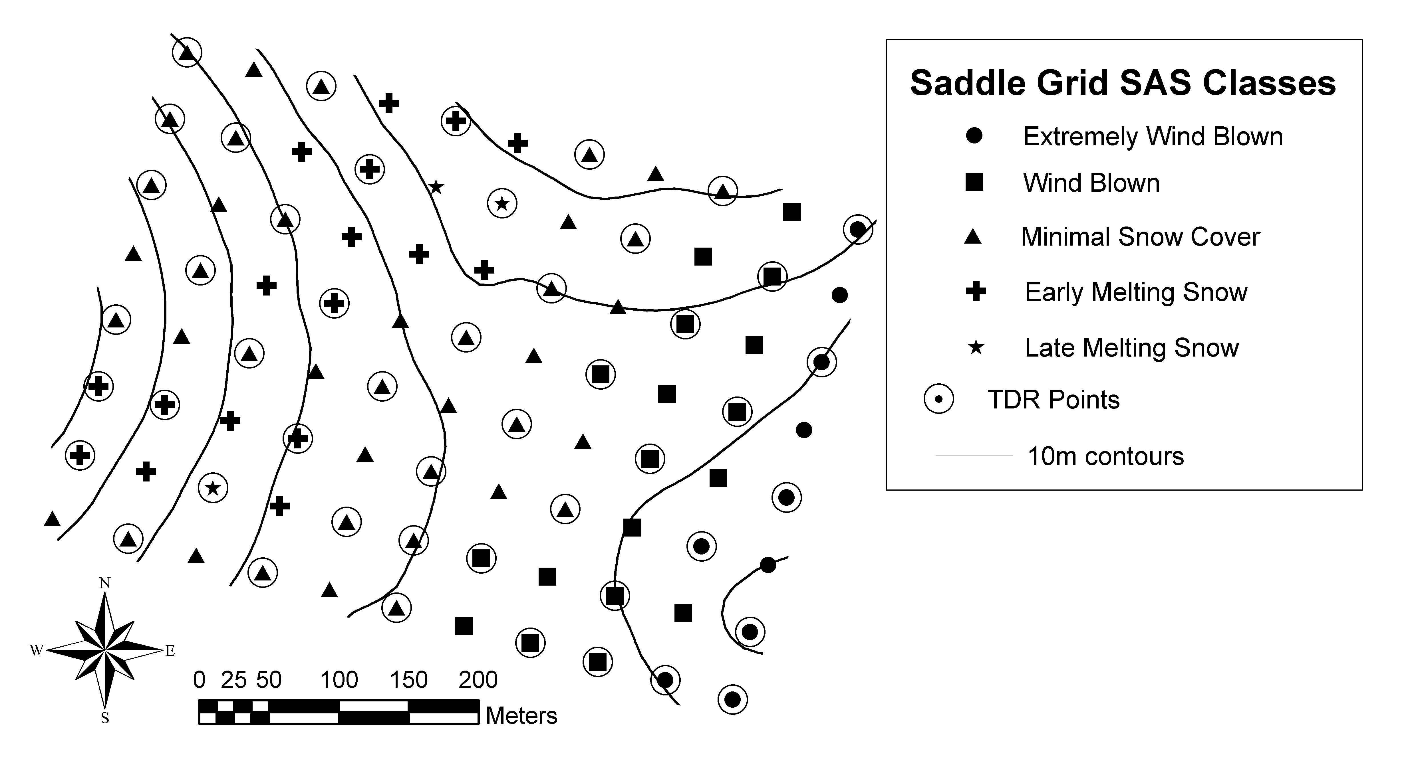
Saddle
Grid
88 points every 50 meters
-biweekly snow depth
-annual NPP
-annual species composition
and coverage

Slide 33
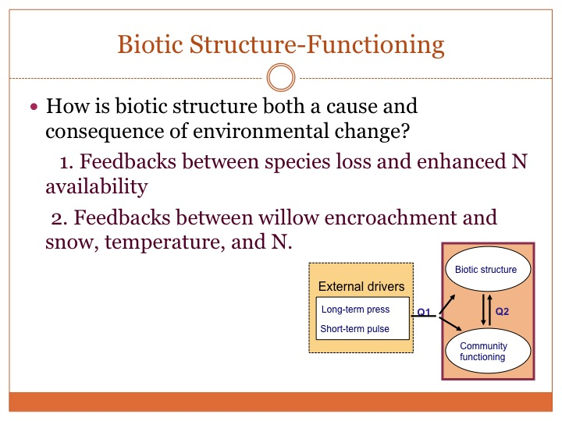

Slide 34
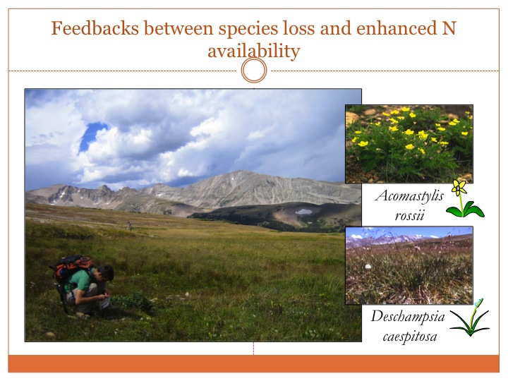

Slide 35
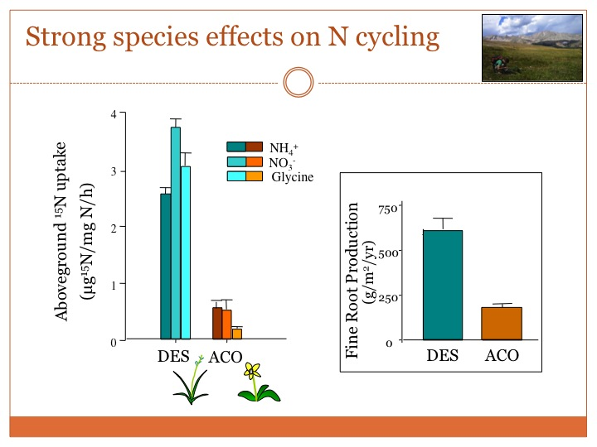

Slide 36
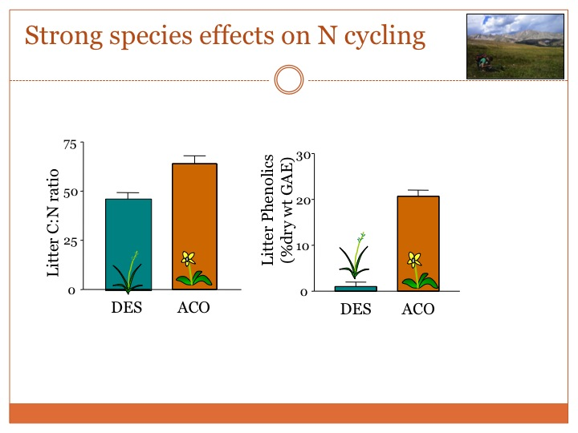

Slide 37
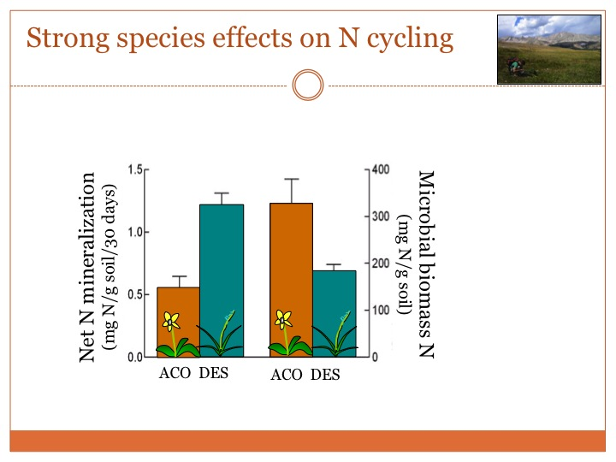

Slide 38
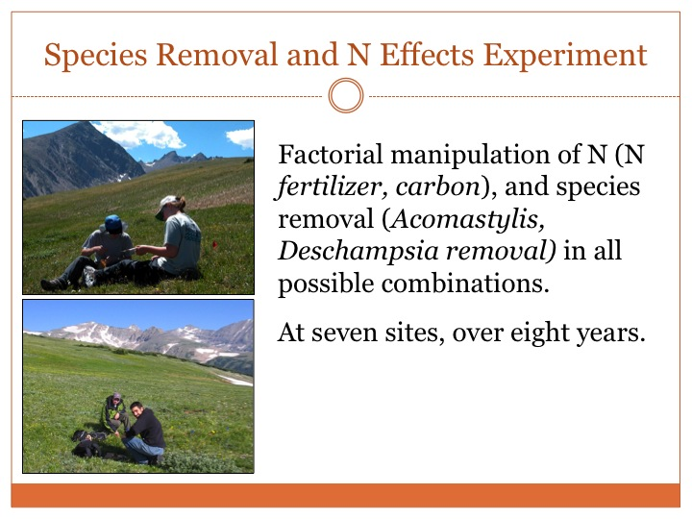

Slide 39
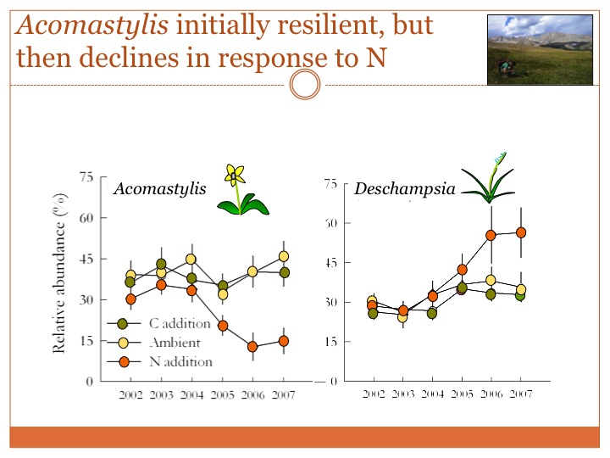

Slide 40
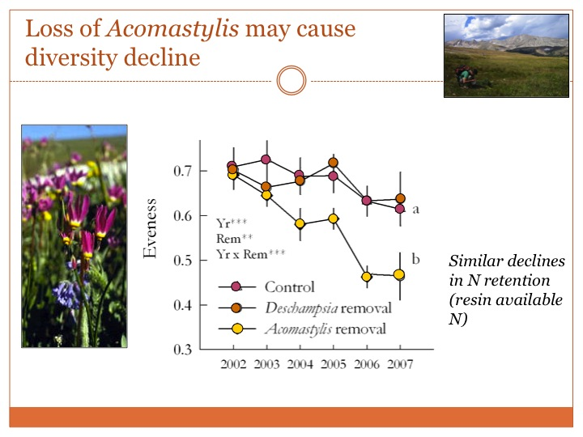

Slide 41
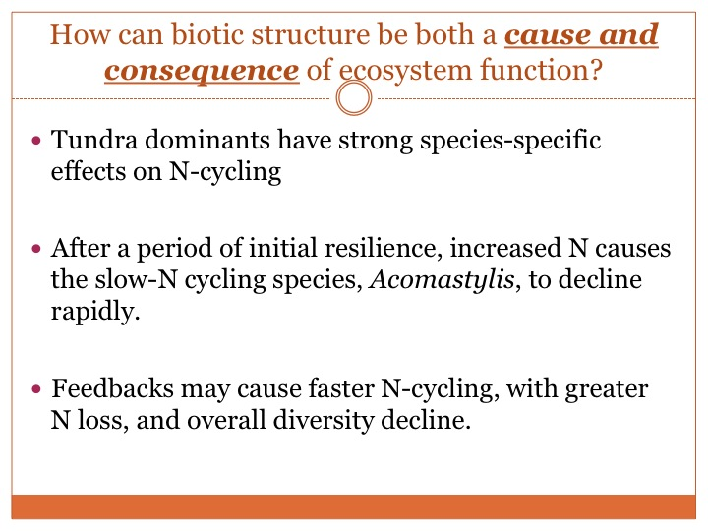

Slide 42
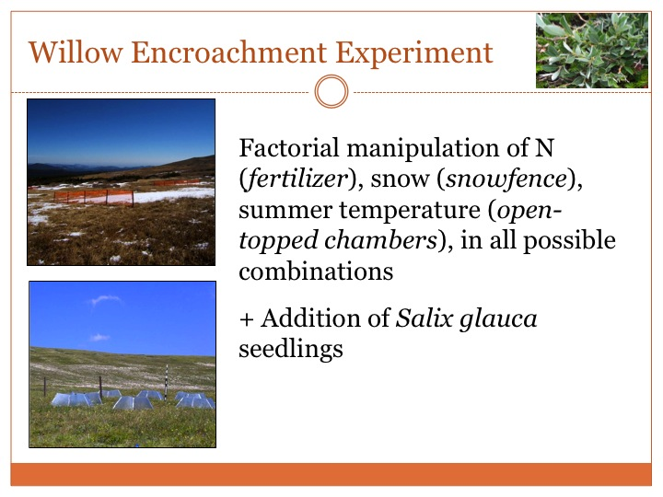

Slide 43
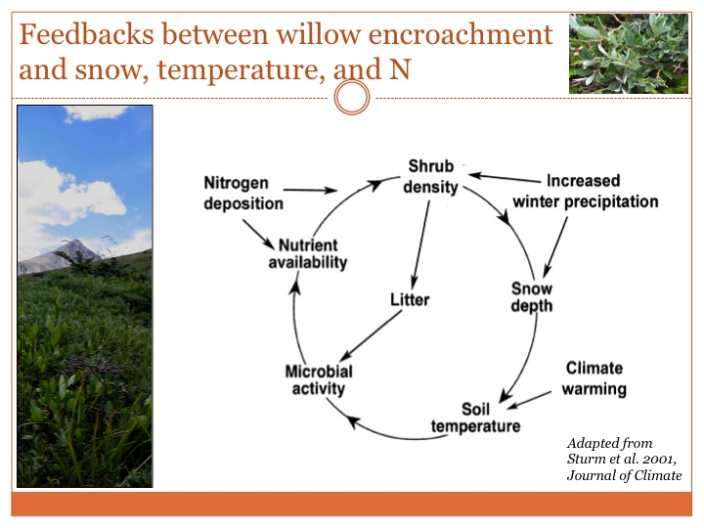

Slide 44
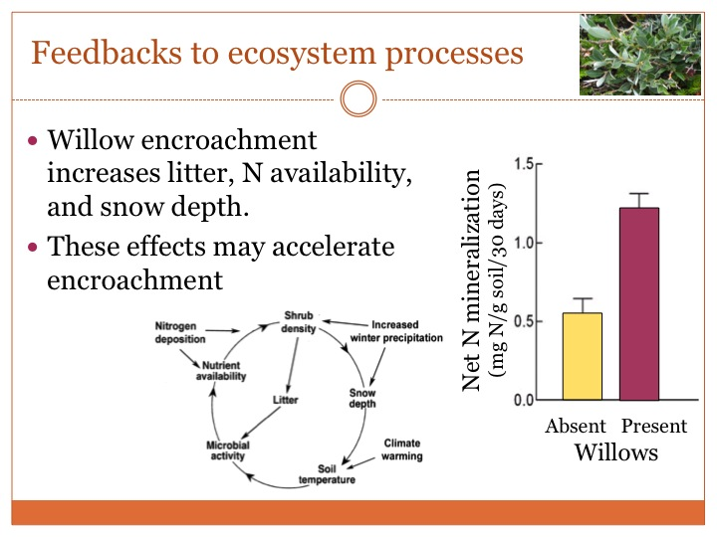

Slide 45
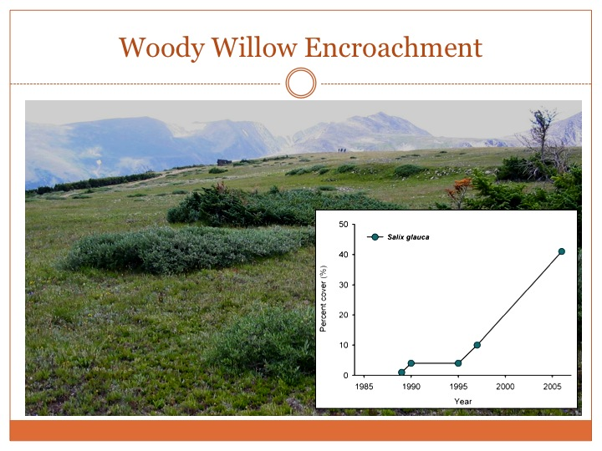

Slide 46
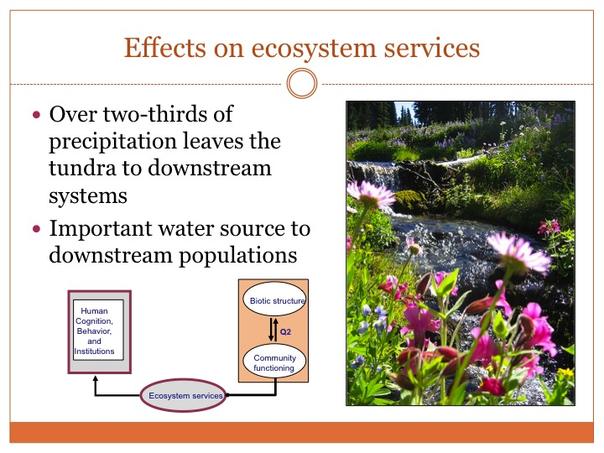

Slide 47
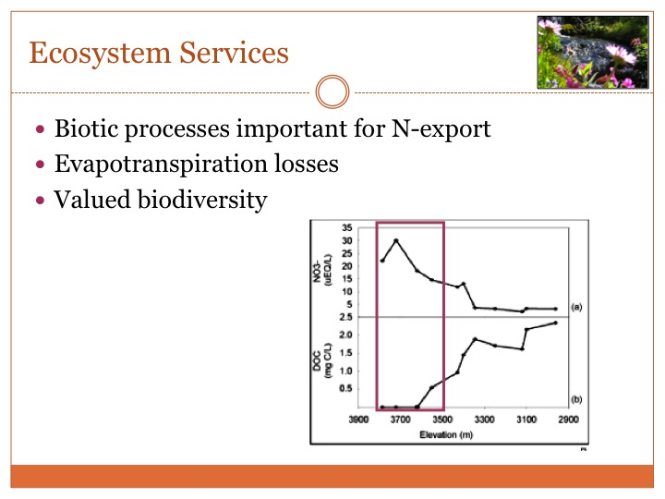

Slide 48
Social-Ecological System Model
Optimal outcomes?
  less risk ⇔ less value; more value ⇔ more risk
  best event for a risk-value combination
OBJECTIVE SPACE
DESIGN SPACE
S
Scenarios
Risk
Non-optimal
Platforms
Efficient Frontier
Pareto Front
Efficient Frontier
Optimal
1/Value
People

Slide 49
Social-Ecological System Modeling
Site 1
Site 2:
land use type
farm/ranch water quality
Site 3
...
Landscape/region:
socio-economic condition & trend
water quantity & quality
wetland/stream condition
Assessment and forecast
Agent behavior
Economics/
Markets
Land
owners
Oil and gas industry
Local governments
State/federal regulators
Decision maker
(game player)

Slide 50
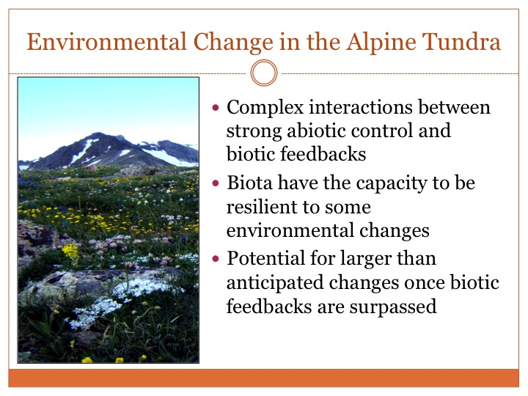

Slide 51
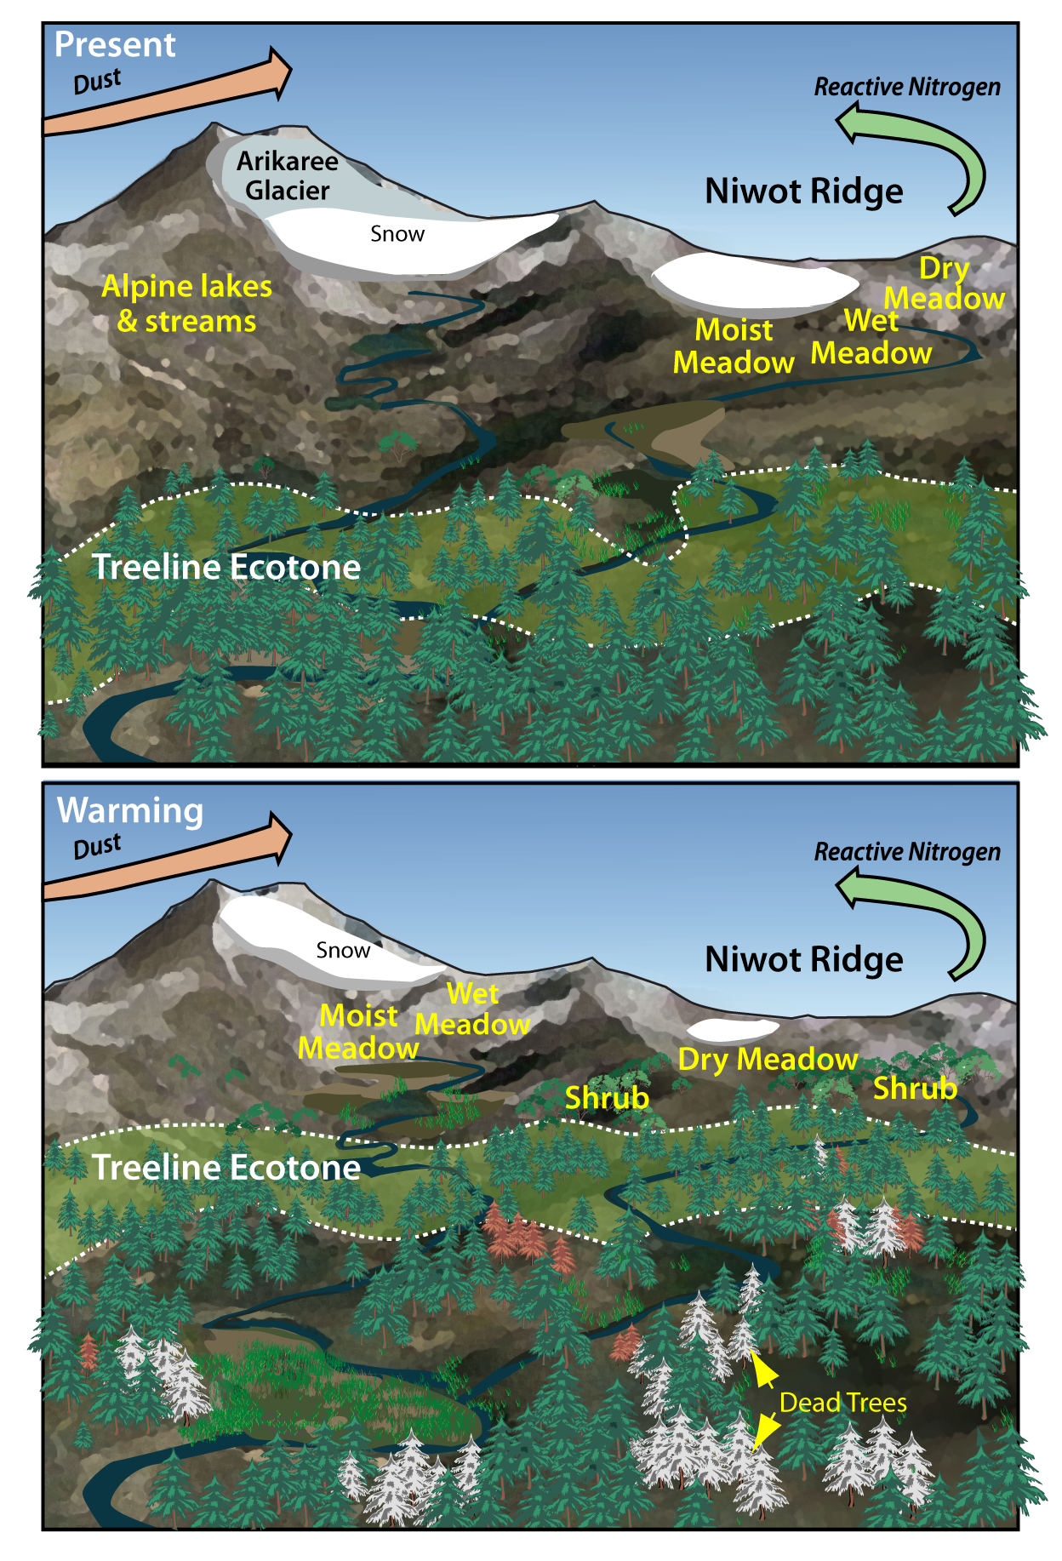
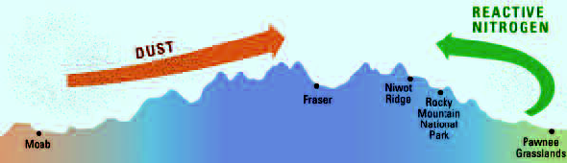
NWT LTER
Additional programs
to regionalize info
NEON
CZO
Ameriflux
DOE
WSC
CHN
Robertson et al. 2012

Slide 52
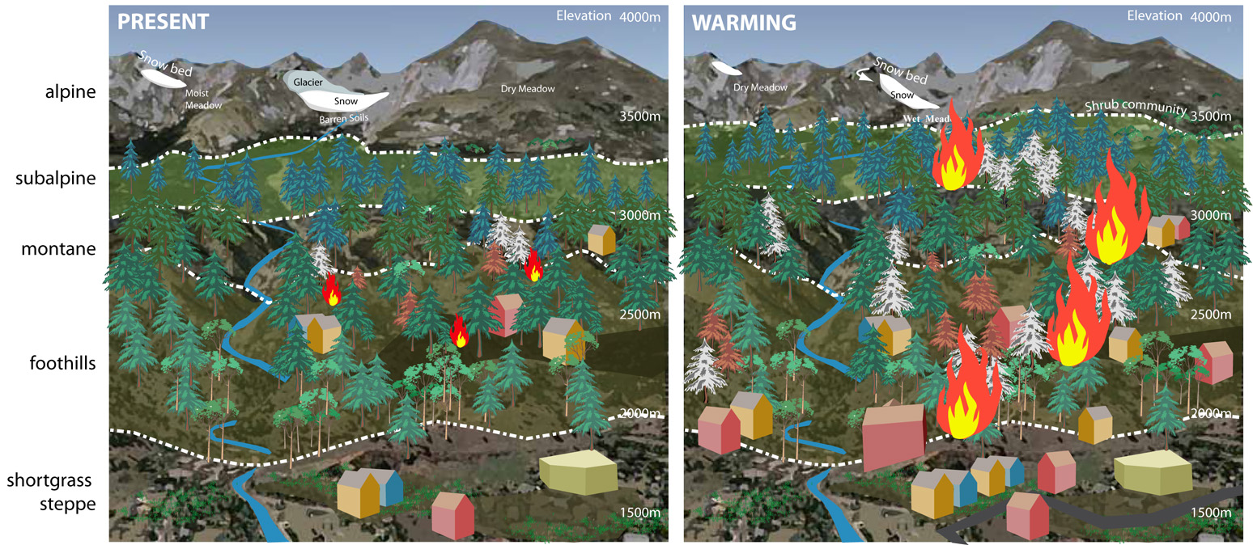
Expected Changes In Connectivity Among Elevation Zones and Disturbance Regimes Related To Climate And Land Use Change

Slide 53
Next steps
Posting on the GMBA LTER webportal list of recommended common protocols
Posting of a background document
Building on other initiatives
Putting out to consultation the system of proposed classification of moutains for site selection and comparative research planning
Establishment of a mountain database, following the consolidation of the classification system
Next group meeting: Mountains Under Watch - 2013

Slide 54

CHARIS - Contribution to High Asia Runoff of Ice and Snow
The CHARIS project began in 2011 with funding from USAID to the University of Colorado
PI:
Richard Armstrong, NSIDC
Co-I:
Mark Williams, INSTAAR
Our study region includes the
Amu Darya, Syr Darya, Indus, Ganges, and Brahmaputra river basins
Map courtesy B. Raup. Glacier coverage from the RGI and GLIMS is in cyan light blue color (See http://www.glims.org/ for information on RGI and other glacier outline data)
http://nsidc.org/charis/

Slide 55

Michele Freppaz in Khumbu

Slide 56
What are the spatial attributes of mountains?
What is the range of these attributes?

Slide 57
Data Sources
world vegetation cover map, vector (Fedorova and Volkova 1990; Fedorova et al. 1993)
1-km DEM (GLOBE Task Team and others 1999)
mean annual precipitation and
mean monthly temperature maps at c. 50-km
the GLC2000 global land cover land cover map (European Commission Joint Research Centre 2003) at c. 1-km resolution.

Slide 58
Parameters
Lat-long
air density class
altitude class
mean annual minimum and maximum precipitation
land use intensity (average value per mountain area)
seasonality.

Slide 59
DRY
High land use
Low land use
WET

Slide 61
Next steps
Posting on the GMBA LTER webportal list of recommended common protocols
Posting of a background document
Building on other initiatives
Putting out to consultation the system of proposed classification of moutains for site selection and comparative research planning
Establishment of a mountain database, following the consolidation of the classification system
Next group meeting: Mountains Under Watch - 2013

Slide 62
http://gmba.unibas.ch/mountainLTER/mountainLTER.htm
Thank you

